Slide 1
The Hidden Cost: Emotional Labor, Mentoring, and Graduate Students’ Well-Being
Yiping Bai, Yiran Chen, John Gonzalez, Heeyun Kim
April 23，2024
AERA 2025 Annual Meeting

Slide 2
Research background and motivation
Mentor-mentee relationships play a critical role in doctoral students’ socialization
Nature’s 2017 PhD survey suggested mentorship contributed more to doctoral students’ overall satisfaction with their PhD programs than did any other factor (Woolston, 2017).
Positive mentor relationship are linked to desirable outcomes such as increased productivity of publications, career self-efficacy and sense of belonging (Curtin et al., 2013; Curtin et al., 2016; Paglis et al., 2006; Tenenbaum et al., 2001).
Poor mentor-mentee relationships result in anxiety and emotional exhaustion, and is also one of the main causes of doctoral attrition (Golde, 2005; Pyhältö et al., 2012; Stubb et al., 2011)

Slide 3
Research background and motivation
Doctoral students are navigating a unique academic experience that mirrors many workplace characteristics and challenges: mentors not only provide tutoring and guidance but also provides financial support by employing mentees as GSIs and GSRAs.
“The combination of low status, high workload, frequent evaluation, competition, in-sufficient supervisor support, and financial duress that employees experience are also common for doctoral students, and likely lead to stress” (Hunter & Devine, 2016, p.37)
The high-stake nature of mentor-mentee relationship motivates doctoral students to manage their emotions to meet mentors' expectations, transforming into what is known as emotional labor (Hochschild, 1979; Wharton, 2009).

Slide 4
Research context: Emotional labor
Emotional labor: the process by which employees are expected to manage or regulate their feelings to meet employer’s expectations, which often requires employees to express or suppress certain emotions during interactions with others (Hochschild; 1983; Wharton, 2009).
Emotional management is usually associated with energy exertion and emotive dissonance, so emotional labor can lead to negative psychological outcomes (Wharton, 2009): i.e., often associated with burnout, a precursor to turnover.
A few studies have used emotional labor in the field of higher ed, mostly focusing on teacher attrition (Bodenheimer & Shuster, 2020; Richardson, 2008; Yin & Chen, 2019).
  Porter et al. (2018) is a rare example that uses emotional labor theory to understand graduate students’ experience (through 24 semi-structured interviews and four focus groups with students from across the four departments)

Slide 5
Significance of Study
Gaps in the existing scholarship
When examining graduate students’ well-being, the emotional and psychological burdens that students experience while navigating the mentor-mentee relationships are largely overlooked;
A few studies have used emotional labor in the field of higher ed, mostly focusing on teacher attrition, but rarely examining its impact on graduate students;
Existing studies on this topic are mainly based on STEMS majors; no existing quant study on this topic as we know of
Contribution of our study
We integrate Self-determination Theory into the emotional labor framework, adapting these concepts to higher ed contexts;
Our study provides new quantitive evidence using a large-scale, longitudinal dataset across a diverse, wide range of disciplines;
By revealing these hidden barriers, we provide an important potential area primed for intervention to improve climate and support student well-being.

Slide 6
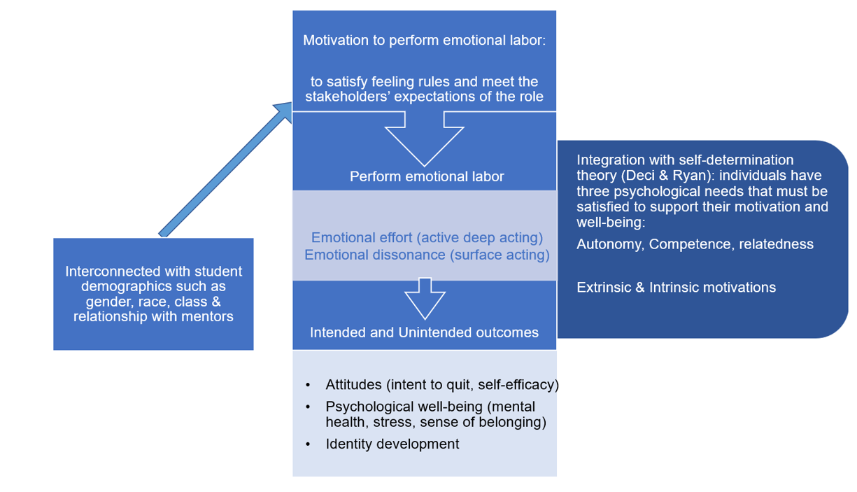
Conceptual Framework
Incorporating Cossette’s framework (2014) and existing literature, we Integrate emotional labor theory and SDT to explore well-being outcomes
Hypotheses: Emotional labor leads to negative outcomes in graduate students’ well-being, especially for underrepresented students, those who are extrinsically motivated and with unmet psychological needs

Slide 7
Research Questions
What factors are related to the performance of emotional labor among doctoral students?
How emotional labor may affect students’ well-being (including mental health, stress levels, efficacy, disciplinary identity, sense of belonging, and intent to quit)?

Slide 8
Data and Methodology
Data Source: Longitudinal survey data from a flagship Midwestern research university (2017-2023)
  participants across all doctoral disciplines (various programs within the physical sciences and engineering, the biological and health sciences, the social sciences, and the humanities and arts) were asked about the mentoring experiences with their primary advisors.
Analytic Sample: 1,110 doctoral students
We use linear regression models and Lagged Dependent Variable (LDV)/autoregressive (AR) models (for RQ2 only), which control for the respective outcome variable in previous years to test the robustness of results and increase the causality of the estimates.

Slide 9
Connecting the theories to survey measures
Based on Hochschild’s framework and prior studies (Kruml & Geddes, 2000; Richardson et al., 2008), we developed a six-item Likert scale (1 = strongly disagree to 5 = strongly agree) to measure students’ emotional labor; utilize factor analysis to identify two related, but distinct, dimensions of emotional labor:
(1). Emotive dissonance (reverse coded): similar to Hochschild’s (1983) notion of surface acting: effort to modify one’s outward expressions to match normative expectations, sometimes concealing their true inner feelings;
1.I show the same feelings to my advisor that I feel inside
2.The emotions that I show the advisor match what I truly feel
(2). Emotive effort: similar to Hochschild’s (1983) notion of active deep acting, change actual feelings to match what they perceive is expected of them
1.I try to talk myself out of feeling what I really feel when helping my advisor.
2.I work at conjuring up the feelings I need to show to my advisor
3.I try to change my actual feelings to match those that I must express to advisor.
4.When working with my advisor, I try to create certain emotions in myself to present the image my school desires.

Slide 10
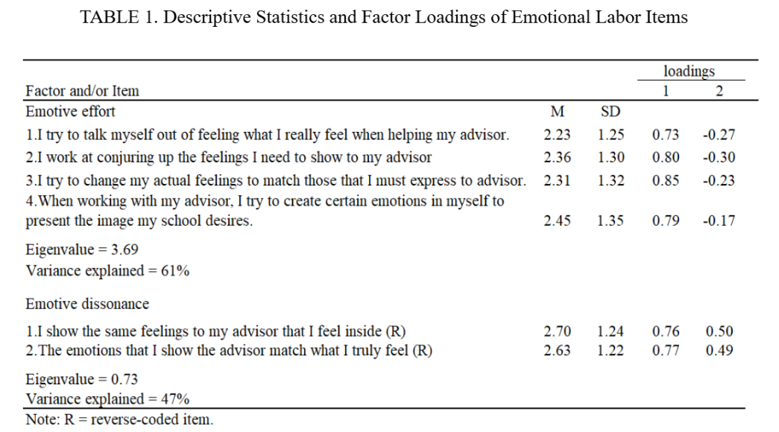
Calculating factor scores
The factor scores of two emotional labor dimensions, namely emotive dissonance and emotive effort, are dependent variables for RQ1 and independent variables for RQ2.

Slide 11
Preliminary Findings

Slide 12
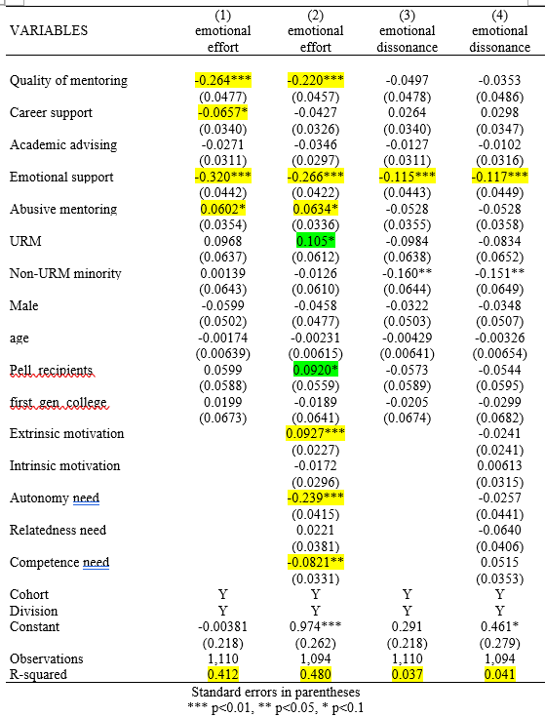
RQ1: What are the “predictors” of the performance of emotional labor?
Populations that are more likely to perform emotional labor:
Those who lack support from their mentors (especially emotional support);
Those who have higher levels of extrinsic motivation (emotive effort);
Those whose autonomy and competence needs are unmet (emotive effort);
URM, Pell recipients (after controlling for the motivation & needs variables)
Our findings align with existing literature: emotional labor disproportionately affect underrepresented student populations

Slide 13
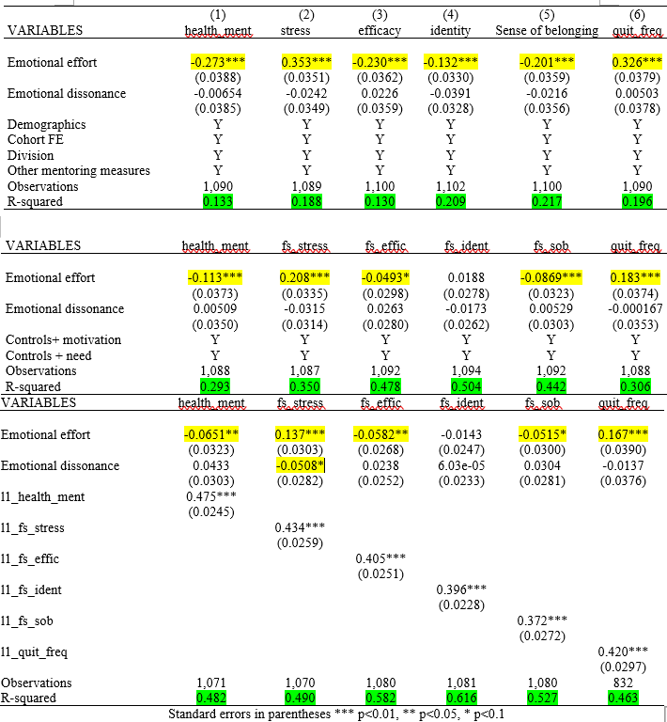
RQ2: How emotional labor may affect students’ well-being?
Emotional labor, especially emotive effort (active deep acting) has negative consequences on students: worse mental health, higher stress level, slower development in self-efficacy and scholarly identity, lower level of sense of belonging, and more likely to quit.
Motivation & needs can explain some of the variation, while the relationship between emotional effort and student outcomes is robust and salient; Even in the models where its “effect sizes” shrinks, emotive effort remains a large “predictor” relative to other IVs.

Slide 14
The hidden cost of emotional labor has been underestimated…
The performance of emotional labor is associated with gender, race and class (Authors, 2025; Wharton, 2009). Porter et al (2018) also highlights the invisibility of emotional labor and the skew of its distribution toward minoritized groups.
The performance of emotional labor show salient, robust relationship with doctoral students’ well-being: may result in worsened mental health as well as a diminished sense of self-efficacy and accomplishment. And even worse, the inauthenticity of emotions may cause individuals to lose their true selves: “By depicting emotions without actually feeling them, workers may face emotional exhaustion while lacking a sense of personal accomplishment…over time, (they may) no longer be able to identify with their work roles, as the line between fake and real feelings dissolves” (Bodenheimer & Shuster., 2020, p.71) and they’re losing some of their true self…
It is pivotal to better understand graduate students’ performance of emotional labor and its influence on their well-being, mitigate the negative consequences of emotional labor and better support graduate students.

Slide 15
The Hidden Cost: Emotional Labor, Mentoring, and Graduate Students’ Well-Being
Thank you!
Any questions?
Yiping Bai, Yiran Chen, John Gonzalez, Heeyun Kim
April 23，2024
AERA 2025 Annual Meeting

