Slide 1
Hostile Advisors
Prevalence, Forms, and Consequences of
Abusive Supervision in Doctoral Education
Yiran Chen, Yiping Bai, Heeyun Kim, John Gonzalez
April 23, 2025
AERA Annual Meeting @ Denver, CO

Slide 2
Three Questions for You:
Statement: There are doctoral students who have been severely mistreated by their advisors.
Q1: Do you agree?

Slide 3
Three Questions for You:
Statement: There are doctoral students who have been severely mistreated by their advisors.
Q1: Do you agree?
Q2: In any given academic year, what fraction of students do you think were mistreated by their advisors?

Slide 4
Three Questions for You:
Statement: There are doctoral students who have been severely mistreated by their advisors.
Q1: Do you agree?
Q2: In any given academic year, what fraction of students do you think were mistreated by their advisors?
Q3: How confident are you in your estimation?

Slide 5
Why Doctoral Students Wanted to Quit?
Quotes from Research Intensive University’s Doctoral Study data (2017–2022)
  "The toxic relationship with my advisor."
  “Because of extremely toxic research advisors.”
  "My advisor was emotionally abusive and did not care about me as a person."
  "Emotional abuse from [name redacted] (verifiable sociopath)"
  “My advisor hates me and holds significant hostility towards me at times and treats me very disrespectfully.”
  “Feeling disrespected and emotionally abused by my advisor”
  “Completely disrespected by my research advisor. Micromanaged. Career is being destroyed by the incompetence of my advisor. Work is ignored. Advisor refused to read papers we are trying to publish leading to year-long delays that damage my career and their impact”
  “Poor treatment by one of my advisors (being yelled at, being treated differently than other students in my group, not feeling valued or welcome).”
  “My advisor was insufferable. I felt like I could not breathe everyday I was in lab with him - it took a toll on my mental health.”

Slide 6
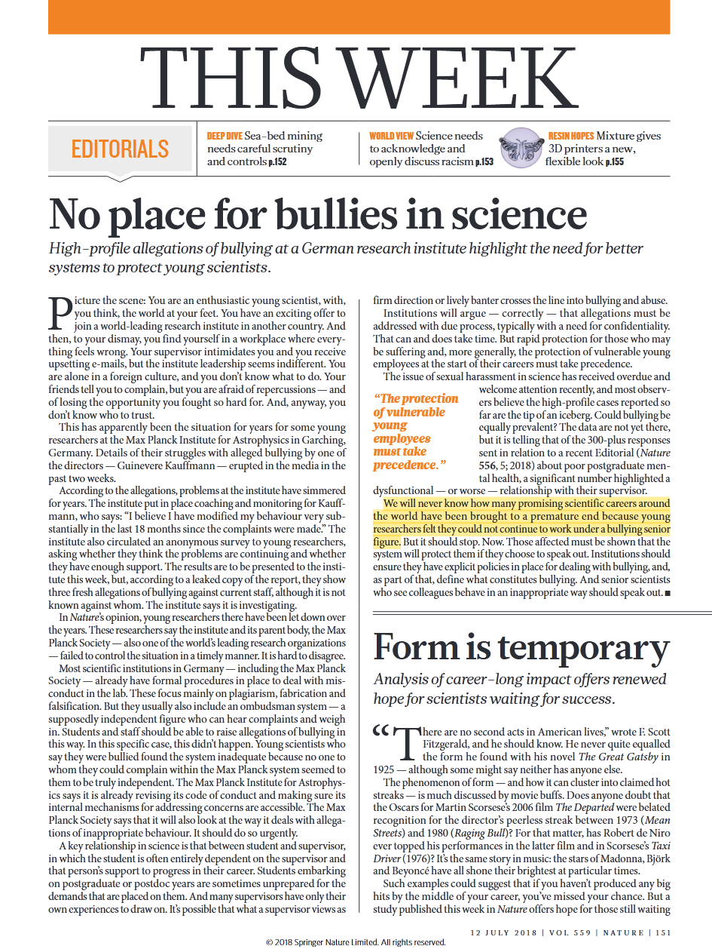
Nobody Has the Answer?!
“We will never know how many promising scientific careers around the world have been brought to a premature end because young researchers felt they could not continue to work under a bullying senior figure.”
—Nature Editorial Board (2018)

Slide 7
Questions to be Answered
How many students have been mistreated by their advisors?
What kinds of mistreatment have they experienced?
How has this mistreatment affected them?

Slide 8
Preview of Key Findings
I conceptualize this phenomenon as abusive supervision
(See handout for definition and measurement scale)
About 5.8% of Michigan doctoral students were abused by their advisors
(up to 12.4% with broader definition).
Women and students in STEM fields are more likely to be abused
(URM and international students show higher risk but not statistically significant).
While failing to give credit, breaking promises, and
reminding students of past mistakes are common,
telling students they are incompetent is the most
revealing indicator of abuse.

Slide 9

Preview of Key Findings
I conceptualize this phenomenon as abusive supervision
(See handout for definition and measurement scale)
About 5.8% of Michigan doctoral students were abused by their advisors
(up to 12.4% with broader definition).
Women and students in STEM fields are more likely to be abused
(URM and international students show higher risk but not statistically significant).
While failing to give credit, breaking promises, and
reminding students of past mistakes are common,
telling students they are incompetent is the most
revealing indicator of abuse.
Except for the most extreme cases, the impact of abuse
seems quite small and statistically insignificant.

Slide 10
CF: Abusive Supervision
In Workplace
Definition
Bennett J. Tepper (2000)
Organizational Psychology
Cited 5974 times
Replicated in over 100 studies
Subordinates' perceptions
of the extent to which supervisors engage in sustained hostile verbal
and nonverbal behaviors, excluding physical contact.

Slide 11
CF: Abusive Supervision
In Academic Context
Definition
Moss (2018): “Scholars call this kind of workplace bullying abusive supervision.”
Cohen & Baruch (2022): drawing on Tepper (2000) to develop a conceptual model to understand advisor abuse.
Meng et al. (2017) and Wang et al. (2024) conducted empirical studies using Tepper’s scale in China.
Students' perceptions
of the extent to which
advisors engage in
sustained hostile verbal
and nonverbal behaviors, excluding physical contact.

Slide 12
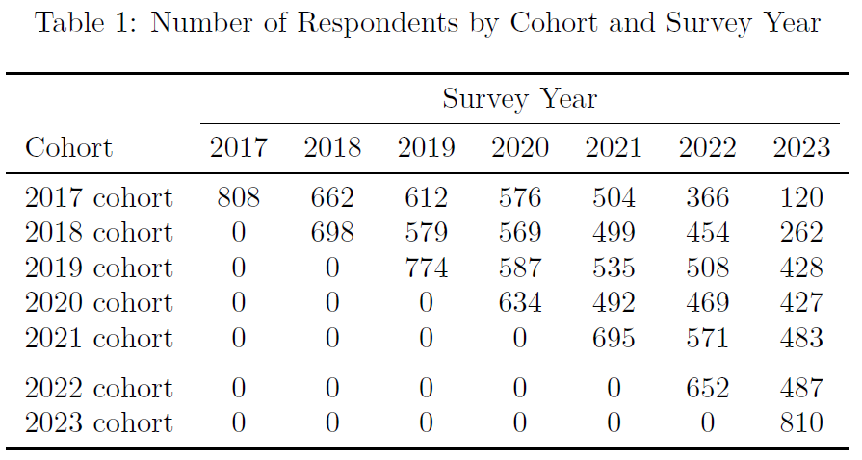
RIU’s Doctoral Experience Study
Longitudinal survey since 2017
  Annual survey in September
  Response rate: 50-60% per year
  Cumulative response: 83%
  Average participation: 2.6 waves
Data size:
  5,778 doctoral students
  15,261 responses
Depth
  200+ items
  Four existing scales for mentoring (quality, academic, career, emotion)
  New in 2023: Abusive Supervision Scale

Slide 13
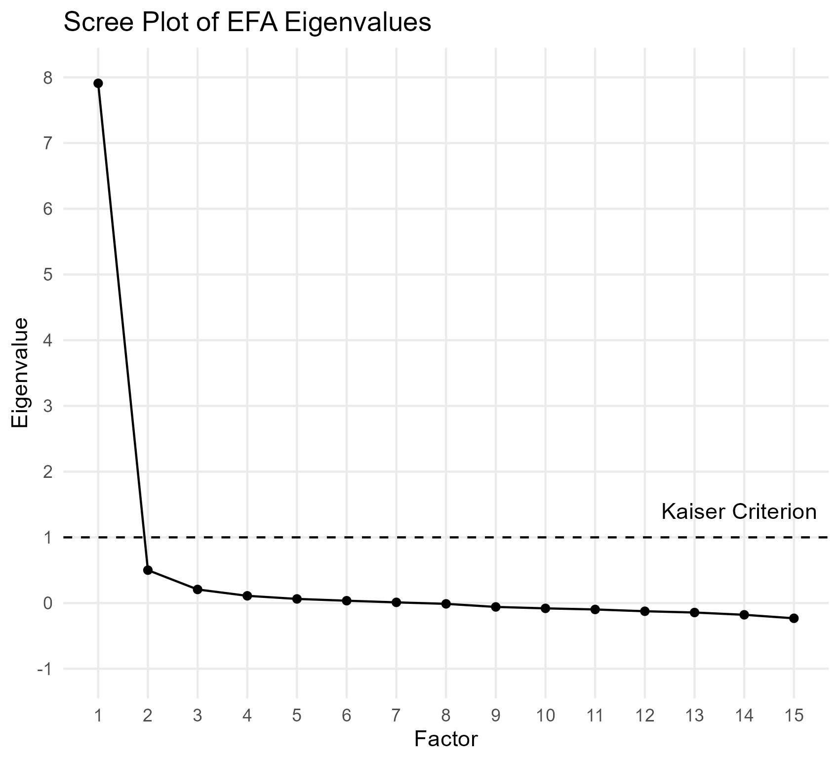
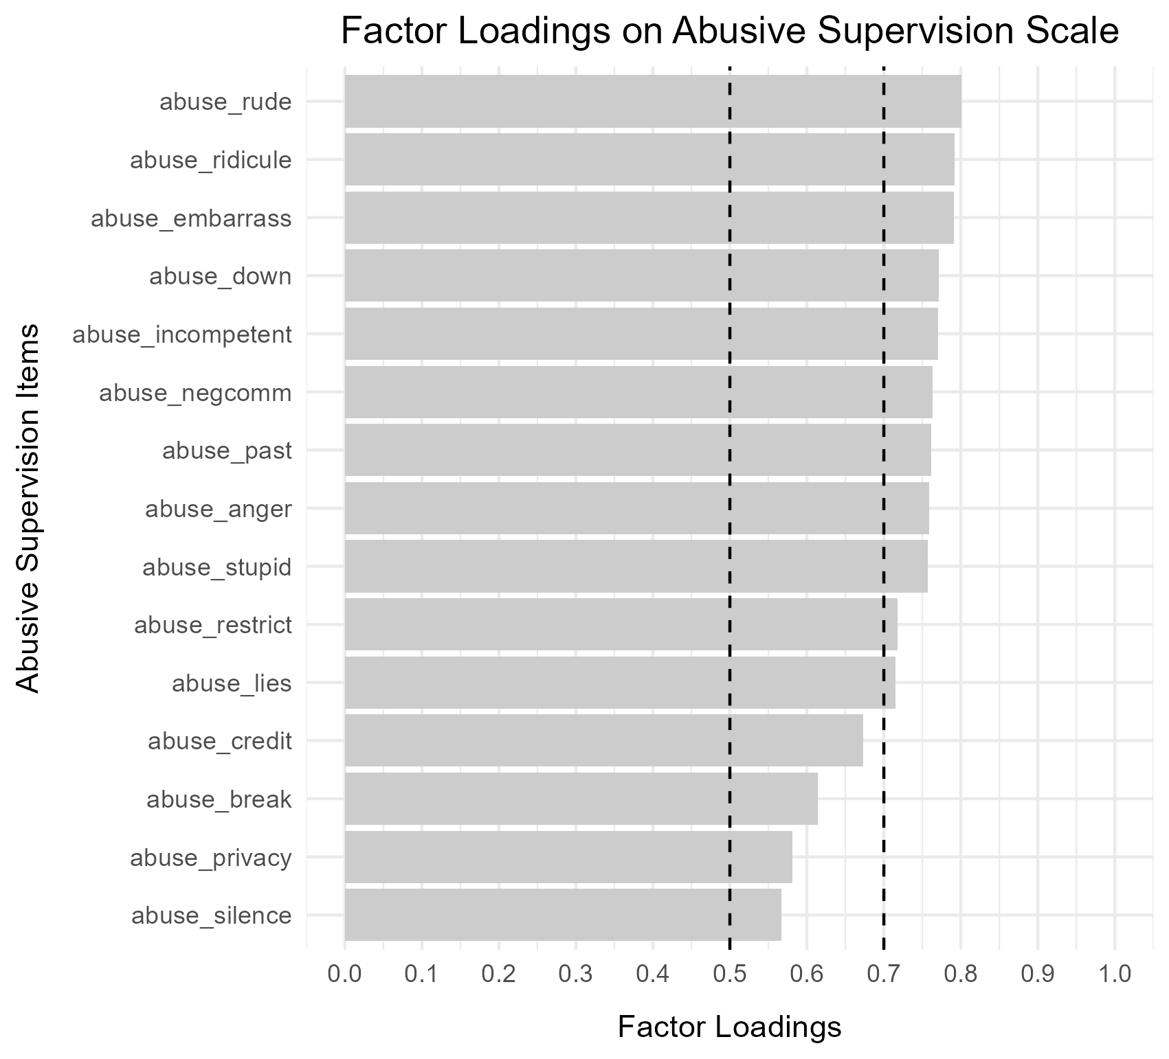
Validation 1: Exploratory Factor Analysis

Slide 14
Validation 2: Confirmatory Factor Analysis
Cronbach's α = 0.938
CFI = 0.911 (Good > 0.95, Acceptable > 0.90)
SRMR = 0.044 (Good < 0.05, Acceptable < 0.08)
RMSEA = 0.097 (Good < 0.05, Mediocre < 0.10, Poor > 0.10)
TLI = 0.896 (Good > 0.95, Acceptable > 0.90, Poor < 0.90)
χ² significant (p < .001) Expected with large sample

Slide 15
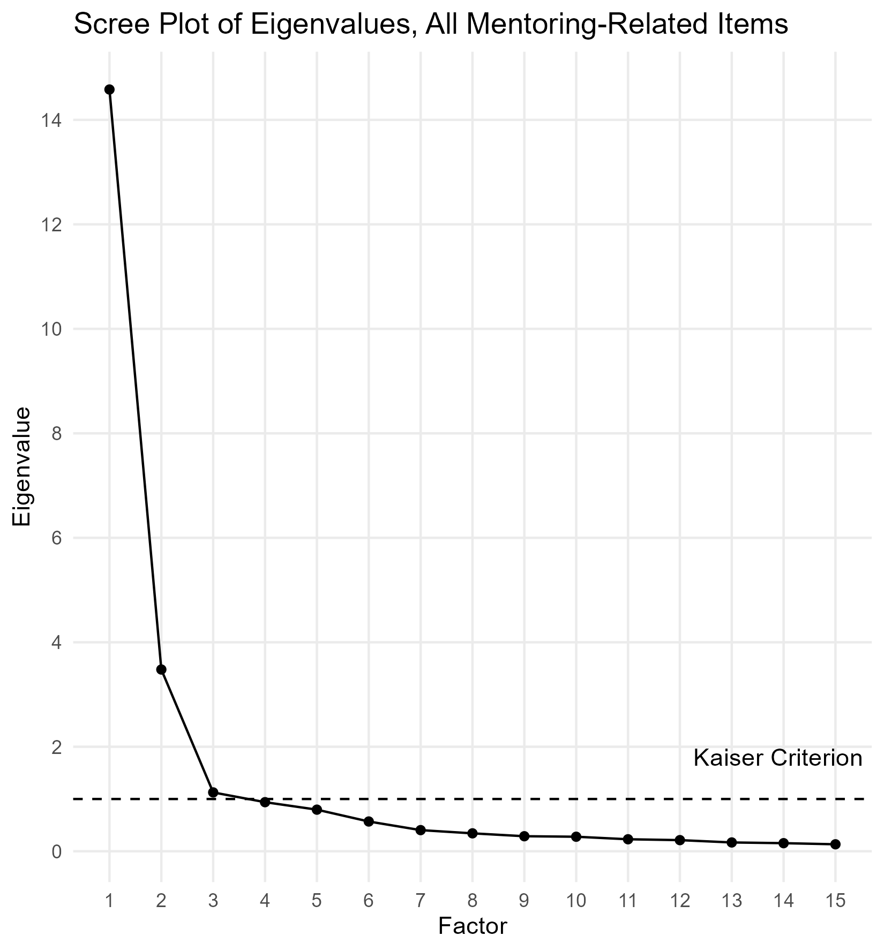
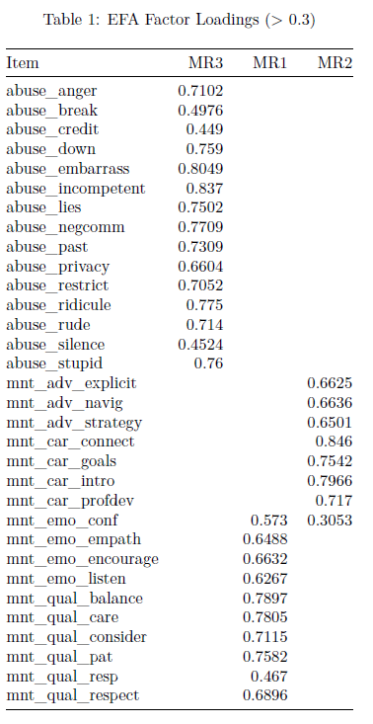
Validation 3: Cross-Loading
abuse
academic and career development
psychological and emotional support

Slide 16
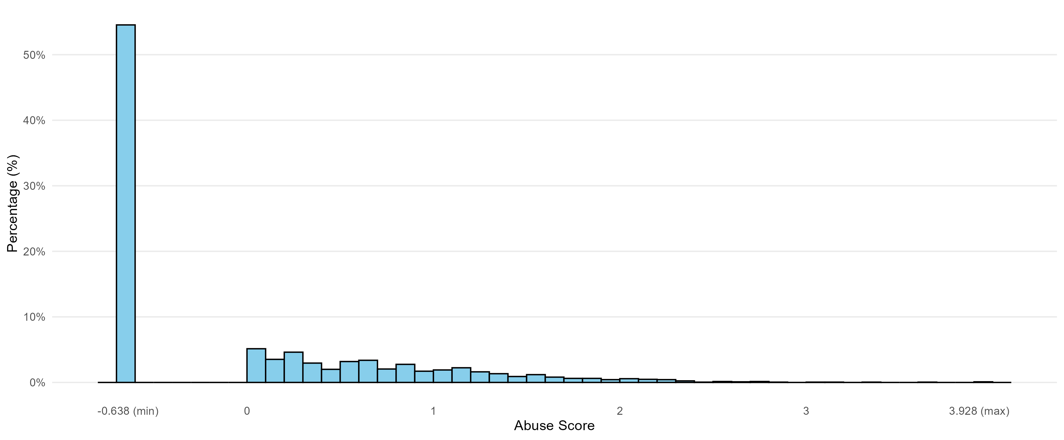
Distribution of Hostility Score

Slide 17
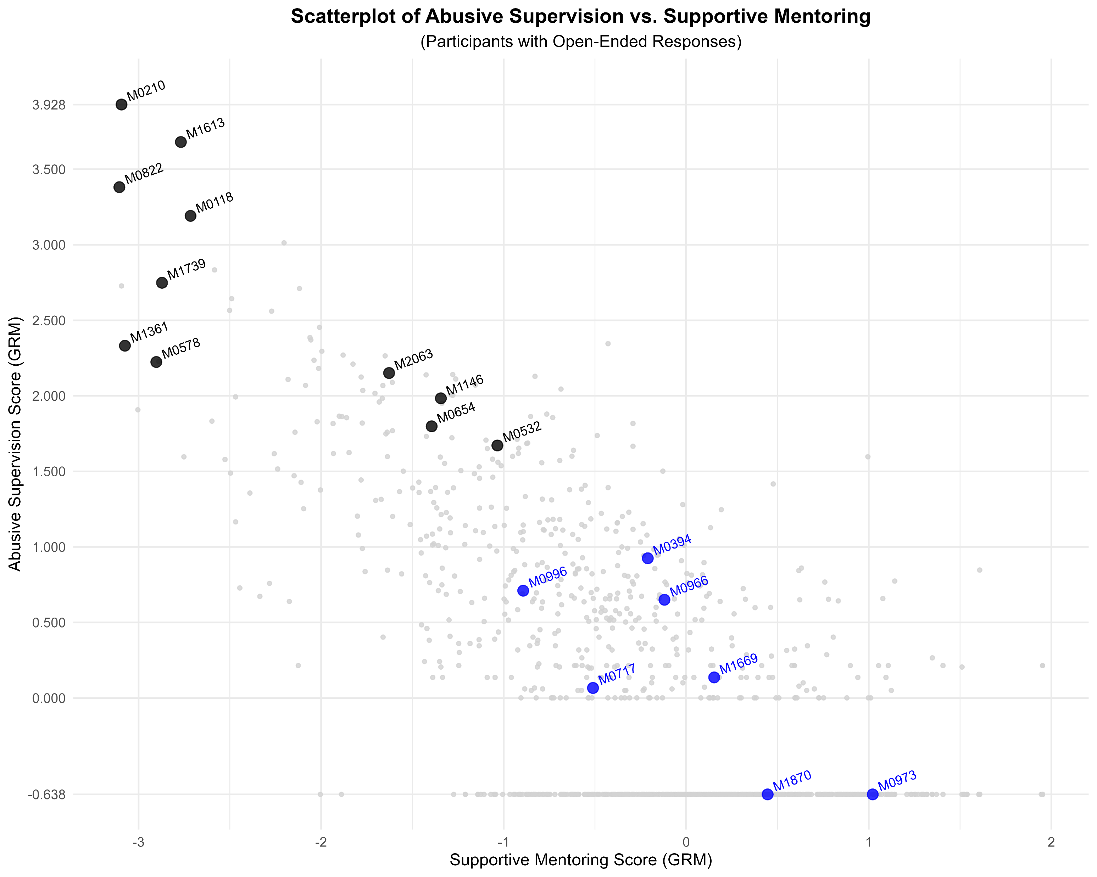
Black dots = Students revealed abusive experience
Blue dots = Students revealed positive experience

Slide 18
“[Expletive] advisor actively working against me”
“Sexual harassment and retaliation [from a sexually abusive advisor] … has made me feel extremely unsafe.”
“professors can easily behaving inappropriate towards students and it seems like there is no punishment for them.”
“Faculty and staff issues/conflicts.”
“My (former) advisor … has been emotional abusive towards me for the last four years.”
“I seemed to frequently end up with toxic mentors and faculty and it made think that there was something wrong with me.”
“Mainly, my advisor. I cannot begin to explain how she has treated me and my coworkers. She constantly gaslights students. She flips authorship in order to assert her control over people and make them feel bad. It is not an exaggeration to say that she probably has narcissistic personality disorder - probably untreated. She will do absolutely anything to get what she wants including abusing students, and delaying their progress in their programs.
She likes to take a project that one student came up with and has worked on and give it to another student and forbid the original student from working on it because she cant come up with research ideas on her own to give to new students.
She never makes her expectations explicit but yet the students are never able to meet them.”

Slide 19
“Immense scrutiny from my academic advisor. Often comments on how my actions are hurting or disadvantaging them. Uses bullying and intimidation to feel powerful. Defends their own actions by pointing out things that have been done wrong. Completely lacks social skills and delivers well-meant feedback unskillfully.”
“Work environment due to advisor mistreating me”
“The relationship with my primary advisor; he consistently made me feel like I was not smart enough for the work.”
“The treatment I received from my advisor. I felt that I was sacrificing my values to stay in the program, particularly my value that I be treated with respect.”

Slide 20
FINAL TEXT: “Genuinely I am the happiest I've ever been in my entire life. I have the best friends, the best relationships with people around me, and the highest satisfaction with my work I've ever had in my entire life. … The biggest downside is that I've gained 30 pounds since starting grad school lol.”
“The main reasons being the lack progress on my part, and the feeling that I, somehow, am wasting my and my advisers' times.”
“[Although] I have an amazing advisor, support system, the expectations of the graduate program are still crushing.”
FINAL TEXT: “Both of my advisors are similar (very kind, very helpful, but also relatively junior faculty with vague expectations).”
“My advisor, while a good mentor, isn't the best at timely feedback or pointing me in directions that advance my career (e.g. publication).”
“My previous Advsior was a very harsh person and used to discriminate against me. It has been really good once I changed my advisor.”
FINAL TEXT: “I'm so thankful to my new advisor for bringing me on board. My quality of life and confidence has improved significantly over the last year.”

Slide 21
(danger zone)
likely abusive
transition zone
likely non-abusive
(safe zone)

Slide 22
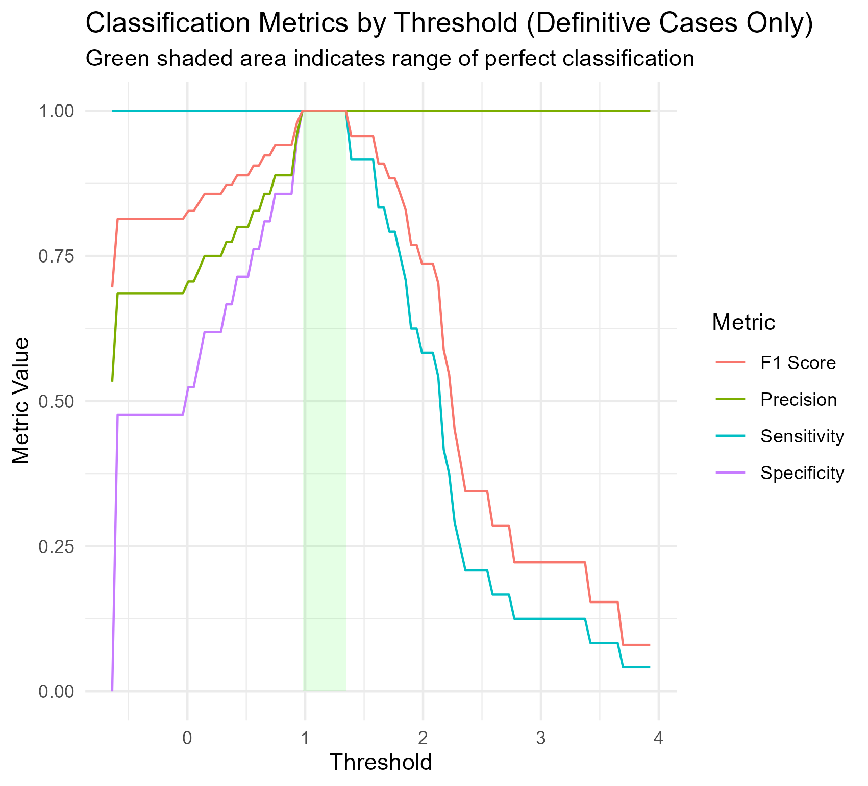
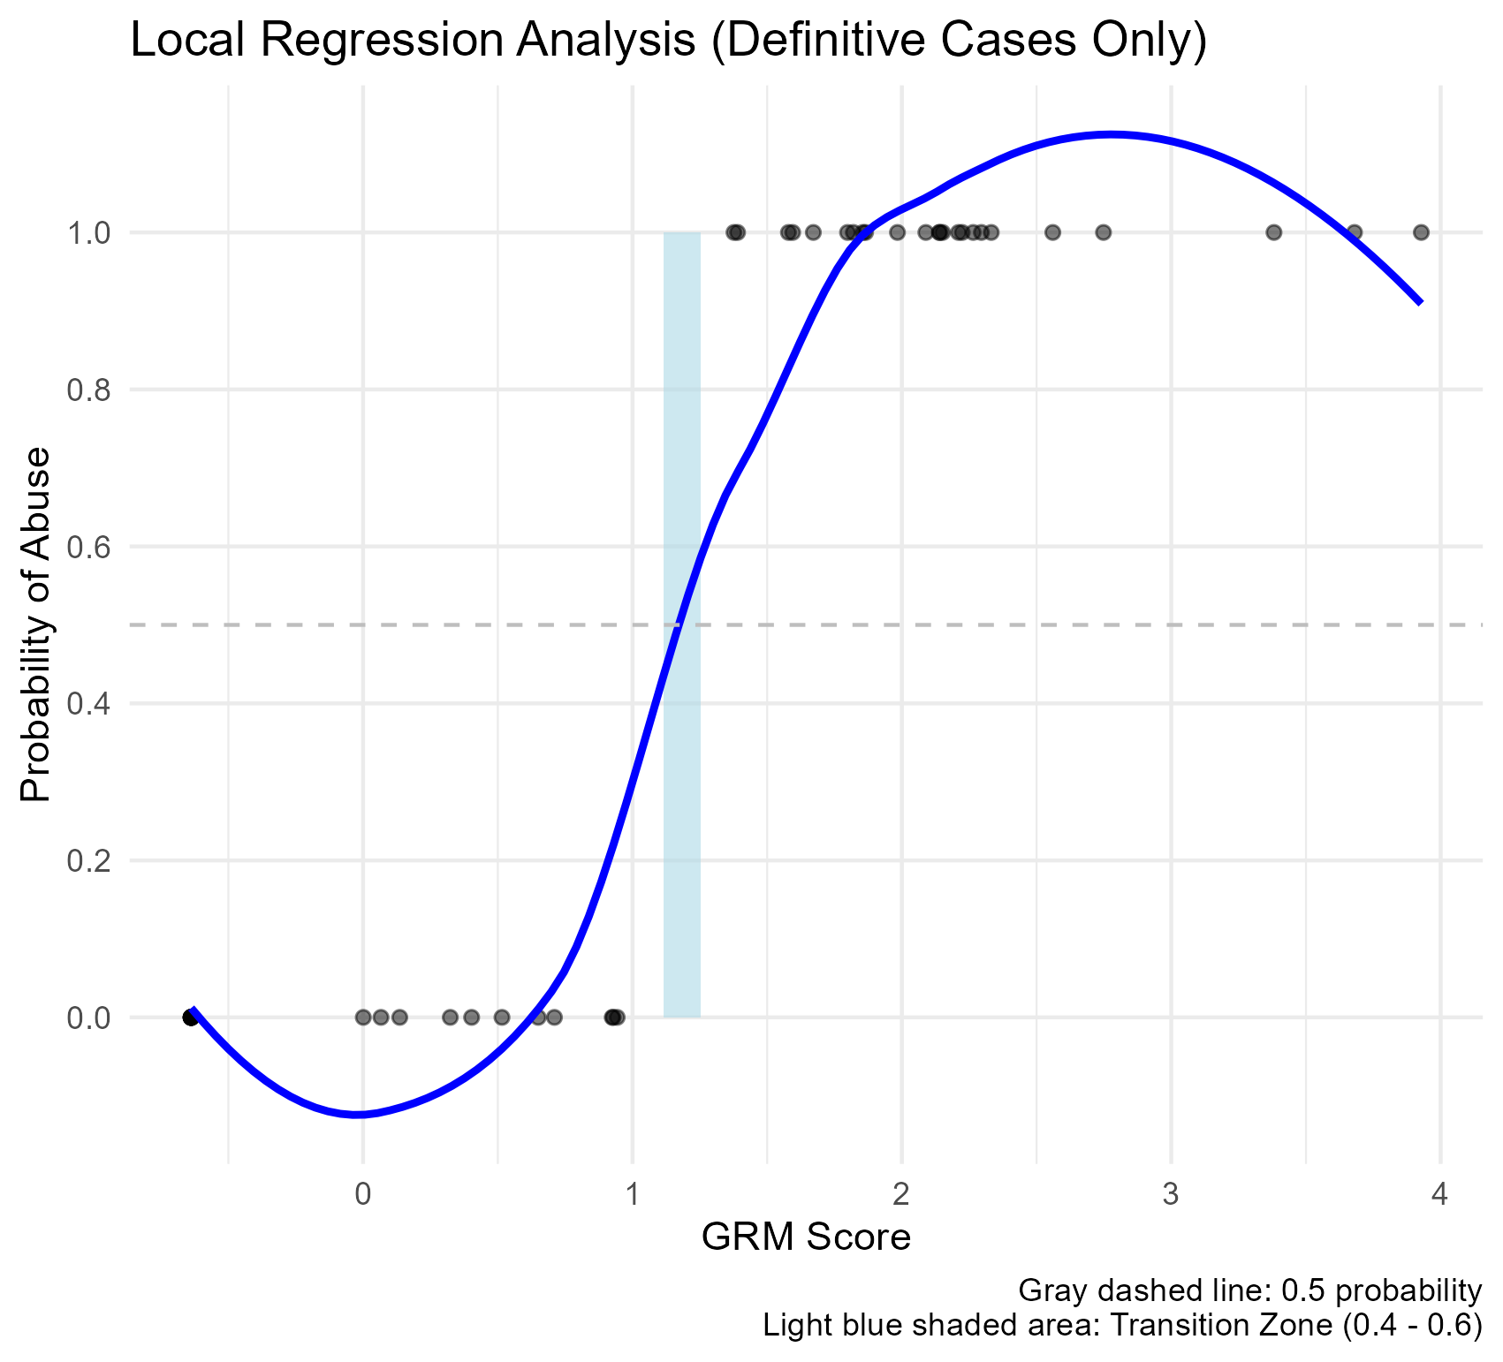
ROC & Local Regression

Slide 23
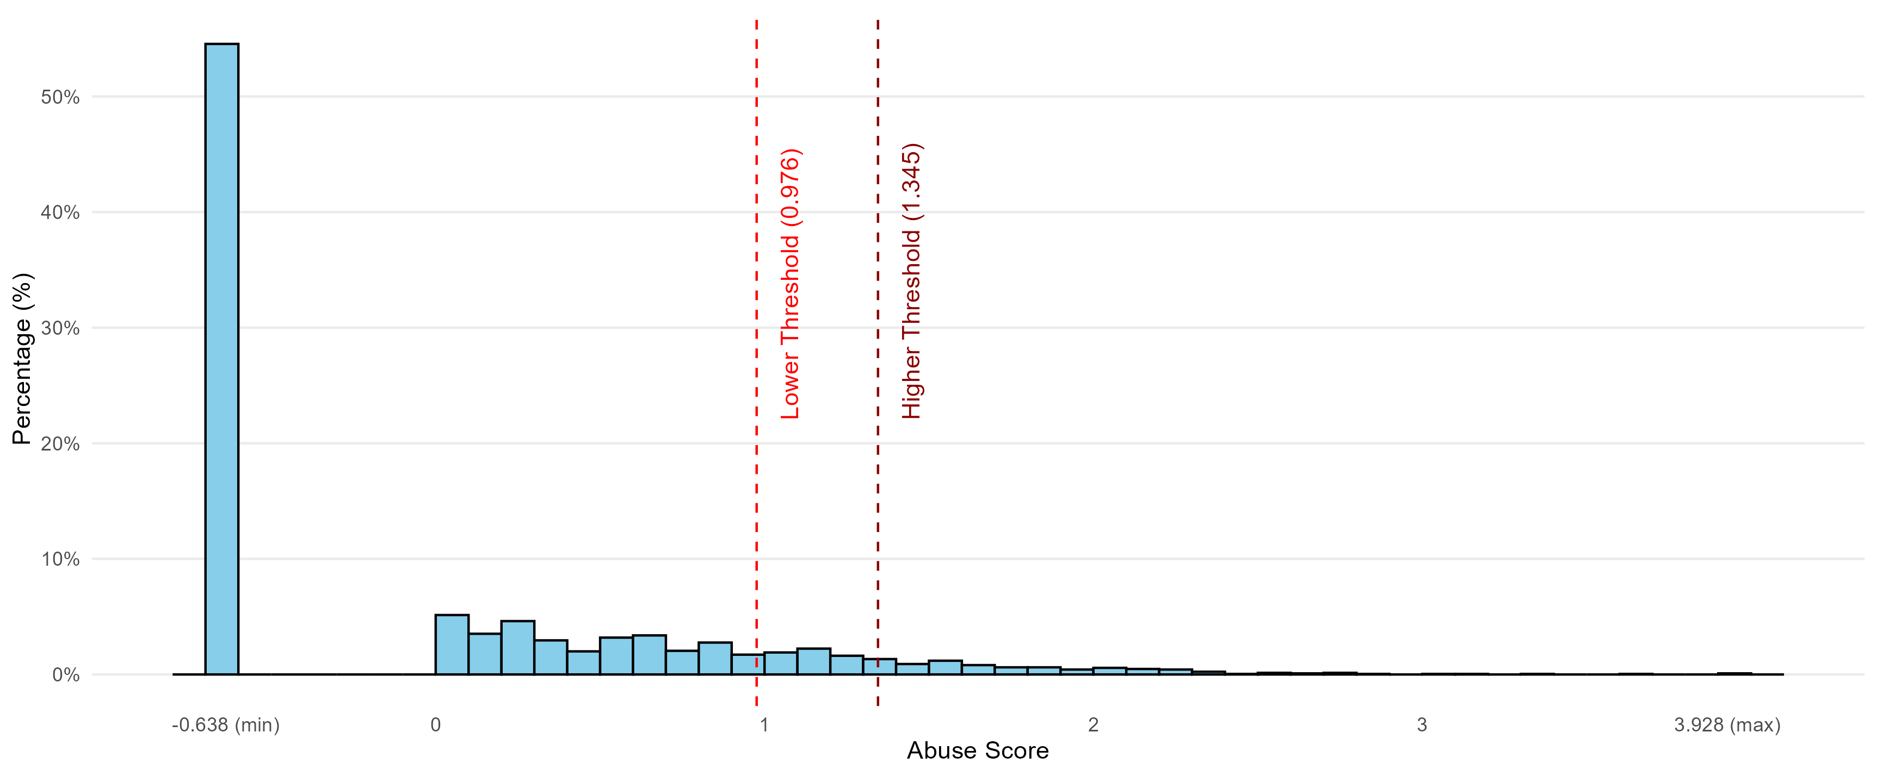
Prevalence: 5.8% (or 12.4%)

Slide 24
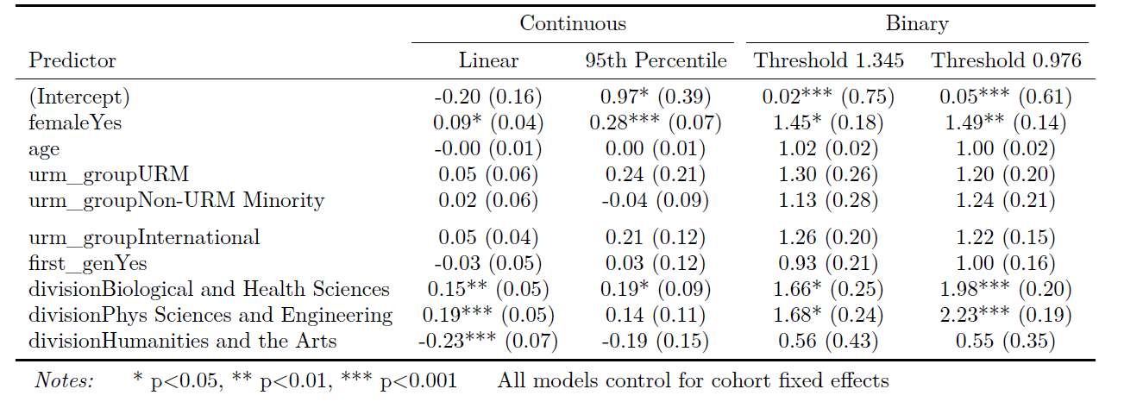
Risk Factors: Women & STEM

Slide 25
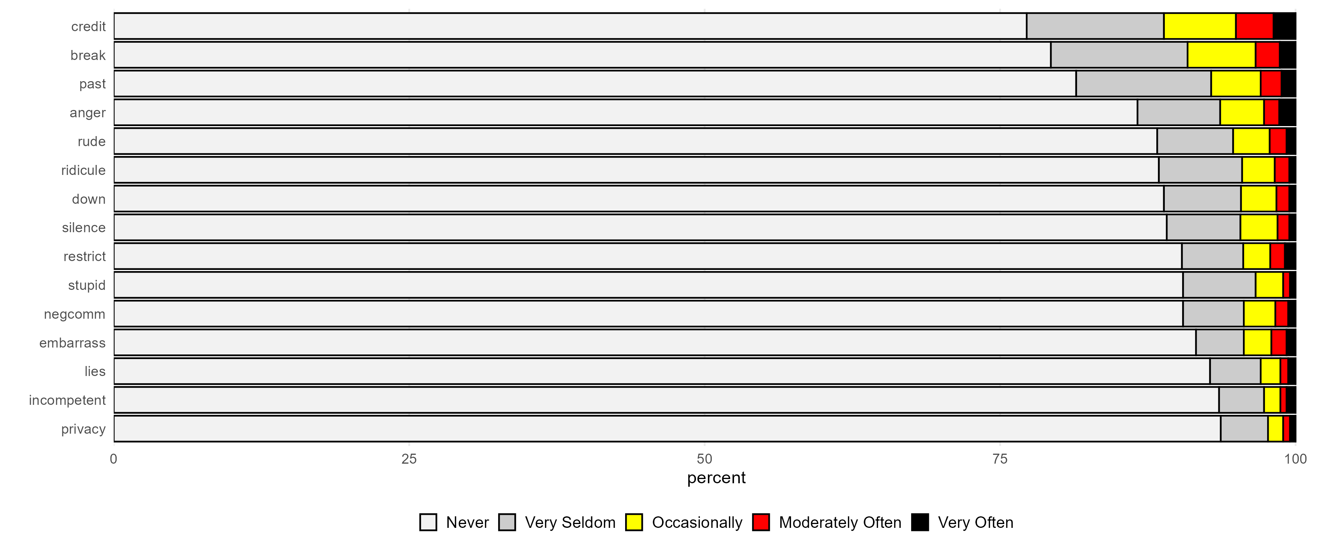
Forms: Frequency Distribution

Slide 26
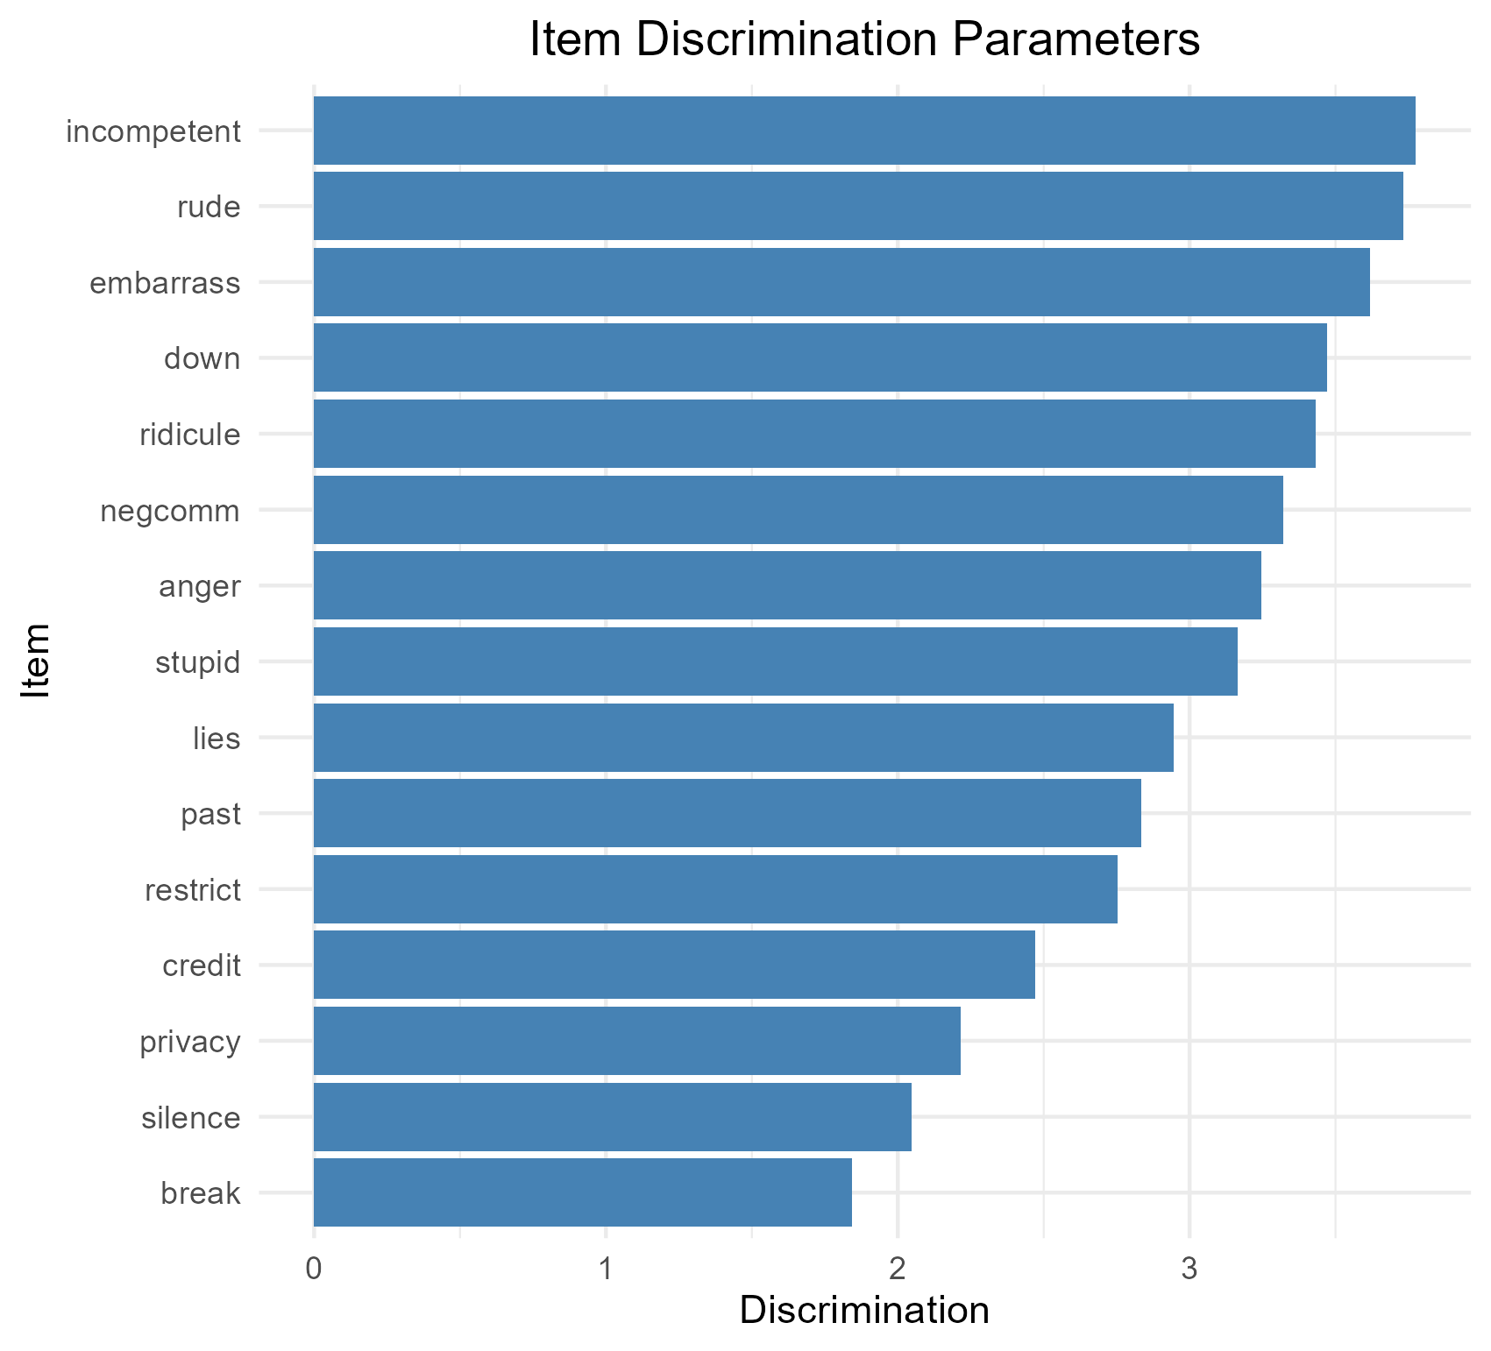
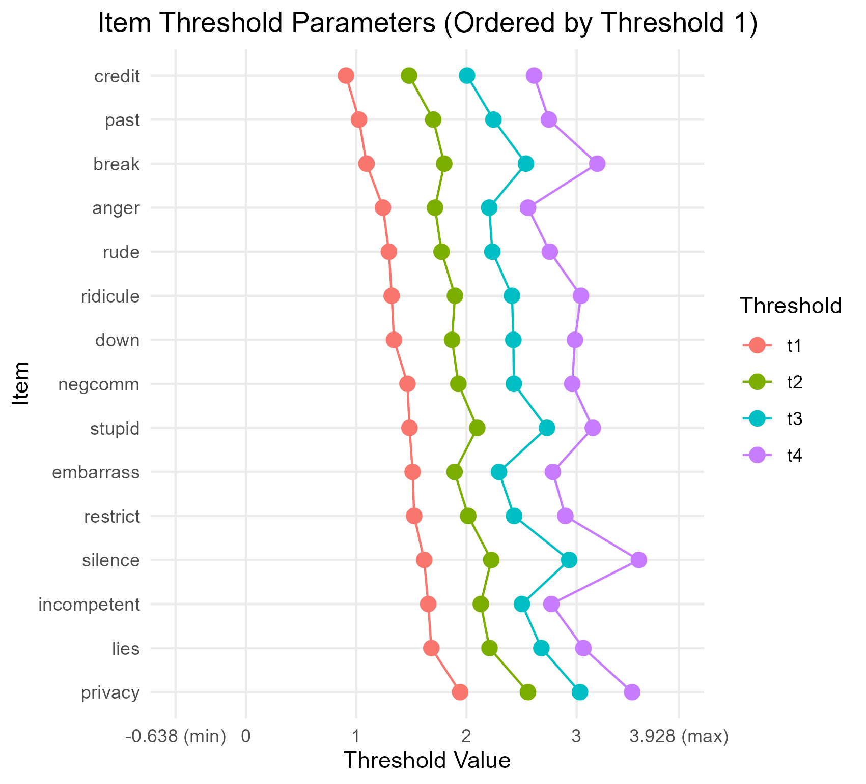
Forms: IRT parameters

Slide 27
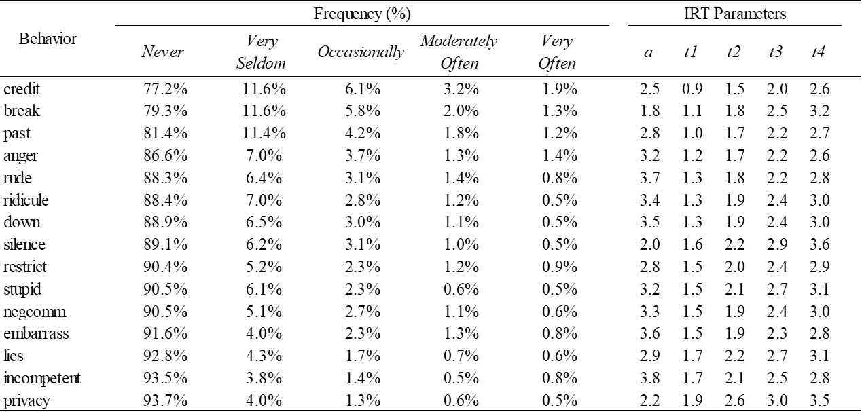
Forms: Table format

Slide 28
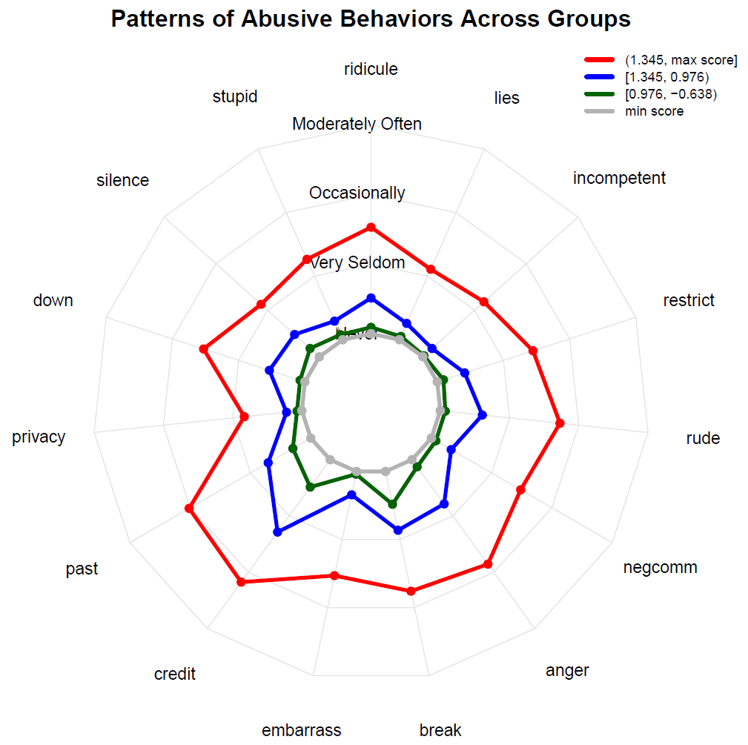

Slide 29
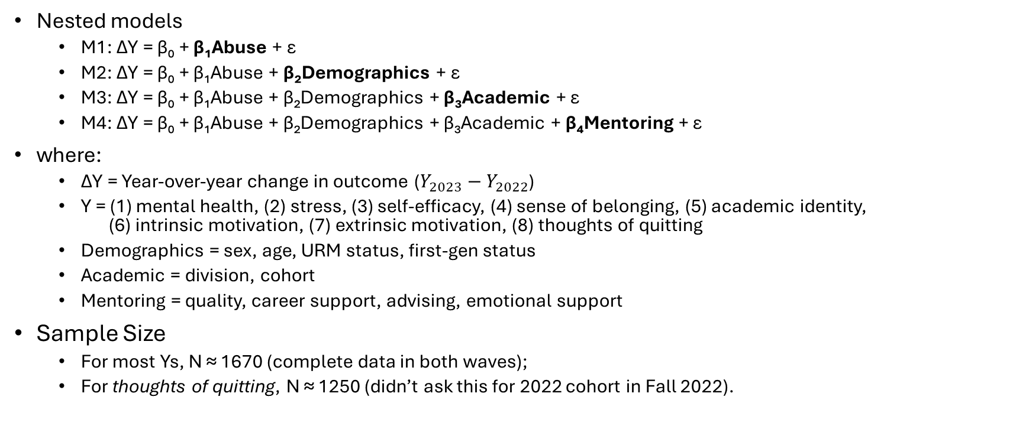
Impacts of Advisor Abuse
Nested models
  M1: ΔY = β₀ + β₁Abuse + ε
  M2: ΔY = β₀ + β₁Abuse + β₂Demographics + ε
  M3: ΔY = β₀ + β₁Abuse + β₂Demographics + β₃Academic + ε
  M4: ΔY = β₀ + β₁Abuse + β₂Demographics + β₃Academic + β₄Mentoring + ε
where:
  ΔY = Year-over-year change in outcome ($Y_{2023}−Y_{2022}$)
  Y = (1) mental health, (2) stress, (3) self-efficacy, (4) sense of belonging, (5) academic identity,
  (6) intrinsic motivation, (7) extrinsic motivation, (8) thoughts of quitting
  Demographics = sex, age, URM status, first-gen status
  Academic = division, cohort
  Mentoring = quality, career support, advising, emotional support
Sample Size
  For most Ys, N ≈ 1670 (complete data in both waves);
  For thoughts of quitting, N ≈ 1250 (didn’t ask this for 2022 cohort in Fall 2022).

Slide 30
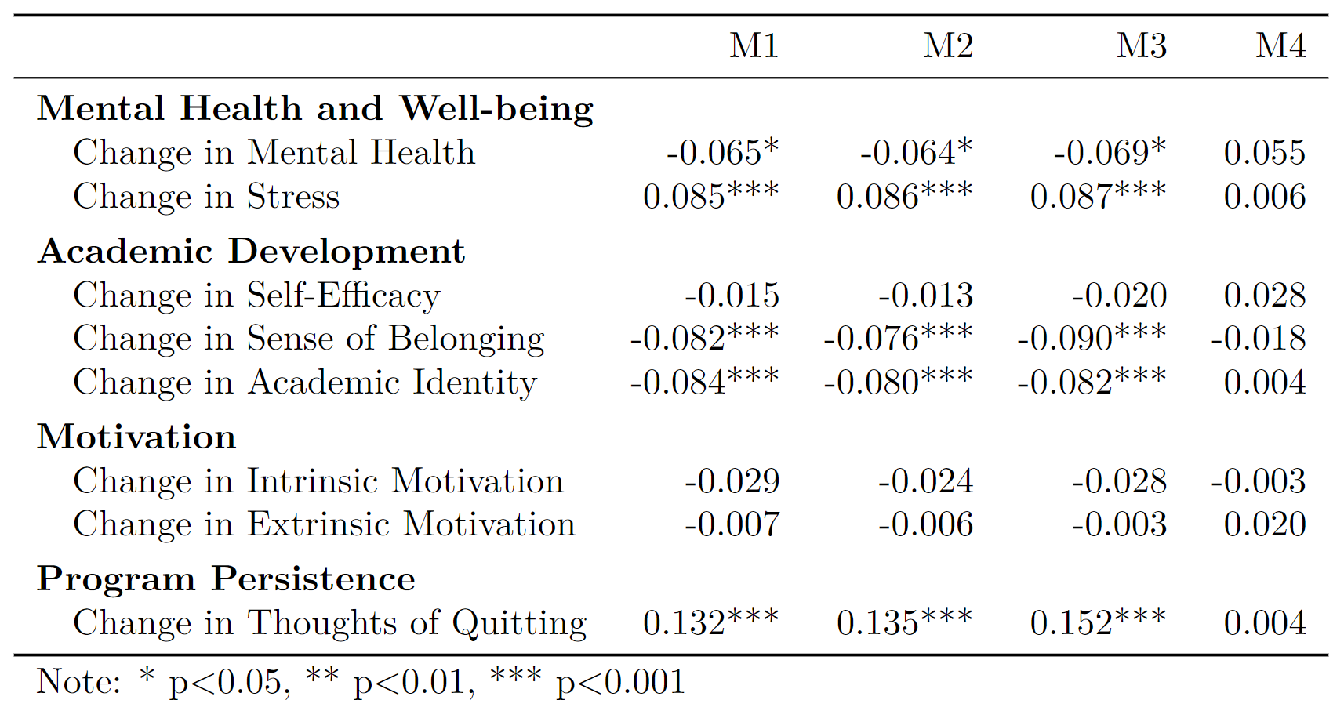
Bivariate Relationship Looks Reasonable
bivariate

Slide 31
Adding demographs & academics
bivariate
+demo
+acad

Slide 32
Small Point Estimates & Insignificant
bivariate
+demo
+acad
+support

Slide 33
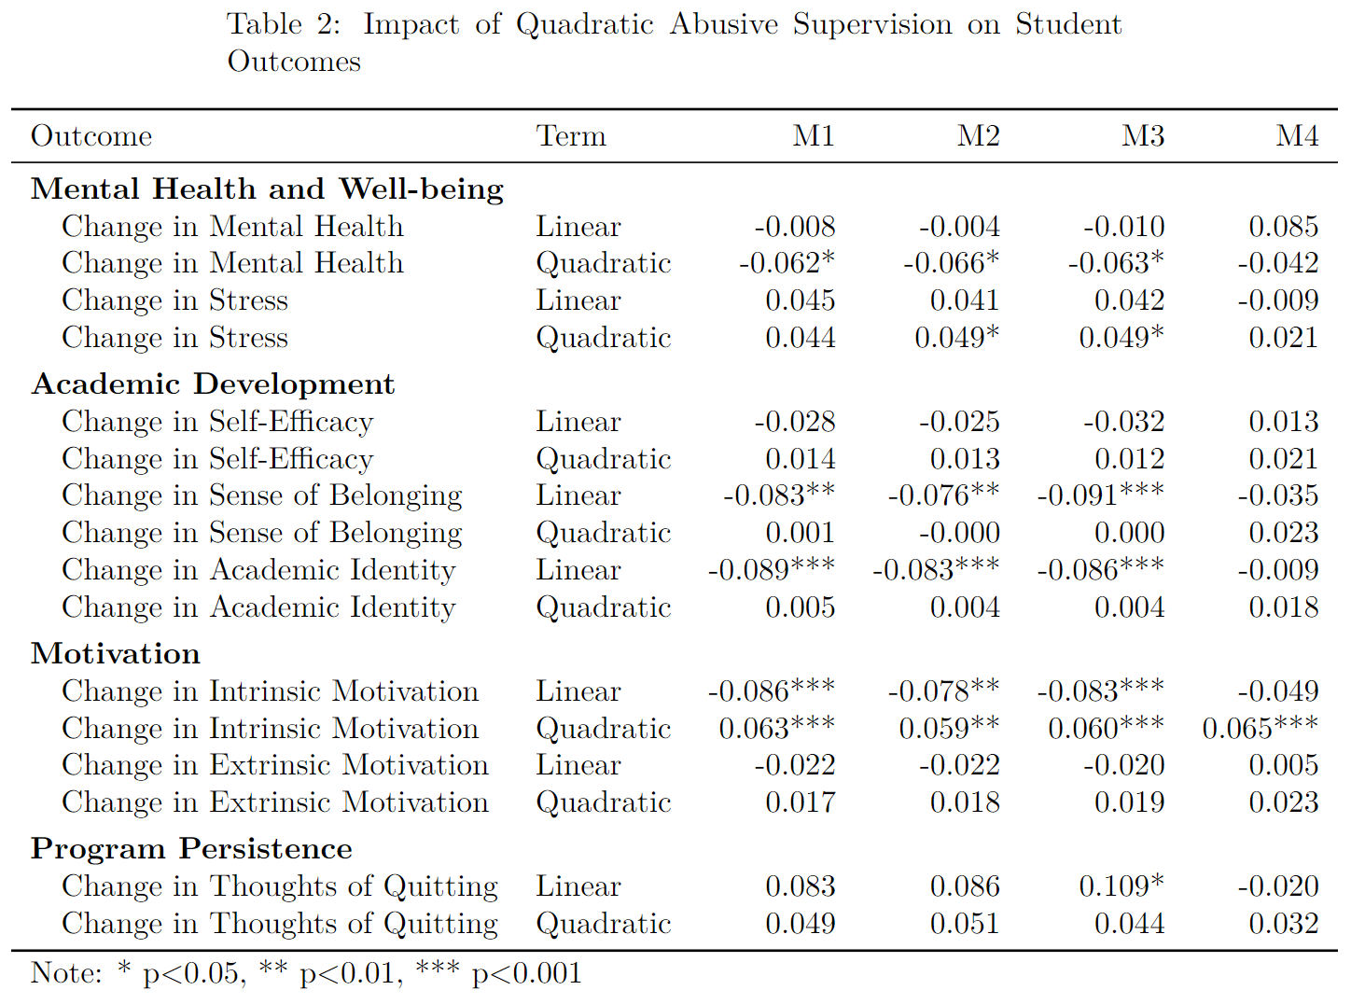
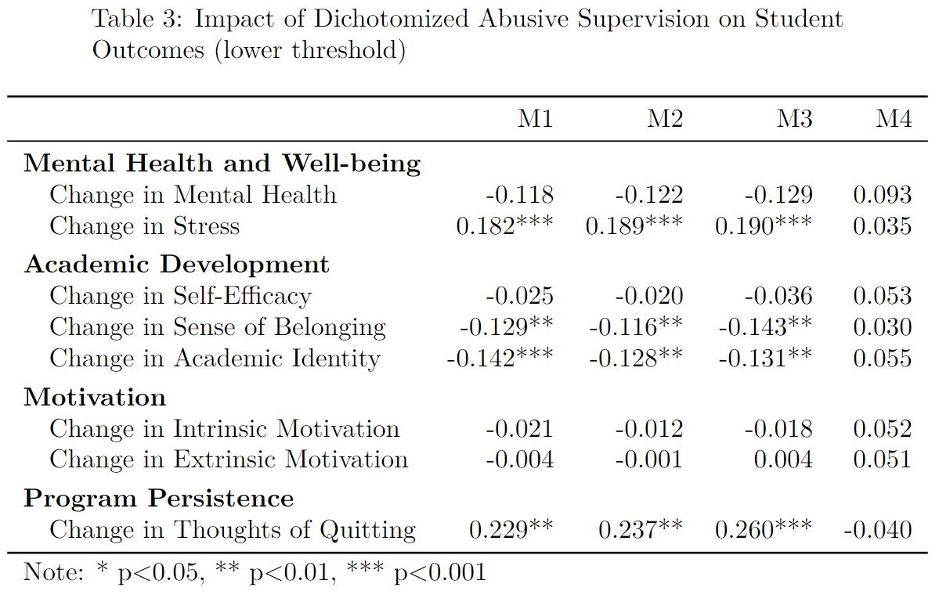
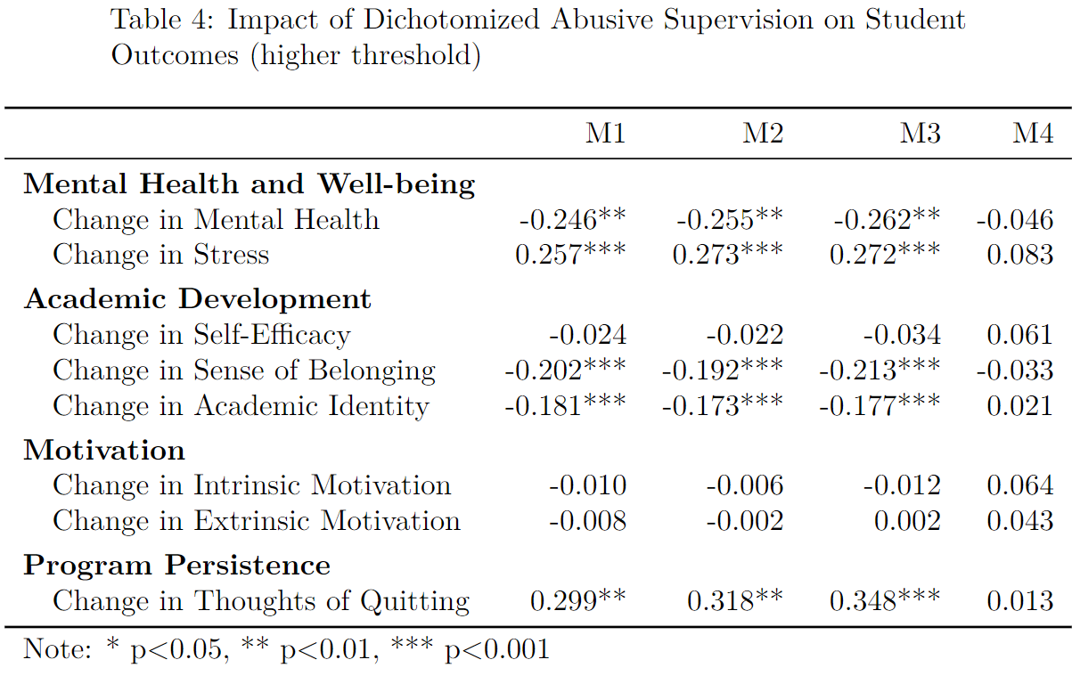
Same Pattern Across Specifications

Slide 34
Thank You!
Questions and Comments?
Key Takeaways:
Advisor mistreatment is a widely recognized but poorly understood issue
Advisor mistreatment can be conceptualized as abusive supervision
Adapted Tepper's Scale shows promising psychometric properties
Threshold for advisor abuse is estimated to be 1.345 SD above the mean
About 5.8% of doctoral students experience advisor abuse (95% CI: 3.2% to 8.8%)
Being female and in STEM fields are associated with higher levels of reported abuse
Telling students they are incompetent is the most revealing behavior
Abuse and support are negatively correlated (r = −.62)
The relationship between abuse and outcomes is nuanced
Corresponding Author:
Yiran Chen
Rackham Graduate School
Institutional Research Office
Email: yiran@umich.edu
On behalf of all co-authors:
Yiping Bai, Heeyun Kim, John Gonzalez

