Slide 1


Findings from the
Michigan Doctoral Experience Study:
Student Well-being and the PhD Journey
Rackham Symposium on Graduate Education Well-Being
October 23, 2025
John Gonzalez, Ph.D.
Director, Rackham Institutional Research
Allyson Flaster, Ph.D.
Senior Research Analyst, Rackham Institutional Research

Slide 2
Research Team
Current Members
John Gonzalez, Director
Yiping Bai, Graduate Student Research Assistant
Yiran Chen, Graduate Student Research Assistant
Allyson Flaster, Research Analyst
Past Collaborators
Paula Clasing-Manquian, Nabih Haddad, Heeyun Kim

Slide 3
Agenda
Prior Research on PhD Student Well-being
Background of the Michigan Doctoral Experience Study (MDES)
Findings Related to Well-being
Take-Aways and Insights
Q & A

Slide 4
Well-being Definition
“Well-being includes having positive emotions (e.g., contentment, happiness), not having negative emotions (e.g., depression, anxiety), satisfaction with life, fulfillment, and positive functioning.
In simple terms, well-being can be described as judging life positively and feeling good.” - CDC
Source: National Center for Chronic Disease Prevention and Health Promotion, Division of Population Health (n.d.) Retrieved from https://archive.cdc.gov/#/details?url=https://www.cdc.gov/hrqol/wellbeing.htm

Slide 5
Well-being Definition
“Well-being includes having positive emotions (e.g., contentment, happiness), not having negative emotions (e.g., depression, anxiety), satisfaction with life, fulfillment, and positive functioning.
In simple terms, well-being can be described as judging life positively and feeling good.” - CDC
Source: National Center for Chronic Disease Prevention and Health Promotion, Division of Population Health (n.d.) Retrieved from https://archive.cdc.gov/#/details?url=https://www.cdc.gov/hrqol/wellbeing.htm

Slide 6
Well-being Definition
“Well-being includes having positive emotions (e.g., contentment, happiness), not having negative emotions (e.g., depression, anxiety), satisfaction with life, fulfillment, and positive functioning.
In simple terms, well-being can be described as judging life positively and feeling good.” - CDC
Source: National Center for Chronic Disease Prevention and Health Promotion, Division of Population Health (n.d.) Retrieved from https://archive.cdc.gov/#/details?url=https://www.cdc.gov/hrqol/wellbeing.htm

Slide 7

Prior Research on Well-being

Slide 8
Fig 1. Number of Articles Published About PhD Student Well-being, by Year
Data source: Martínez‐García, I., De Witte, H., García‐Martínez, J., & Cano‐García, F. J. (2024). A systematic review and a comprehensive approach to PhD students' wellbeing. Applied Psychology: Health and Well‐Being, 16(4), 1565-1583.

Slide 9
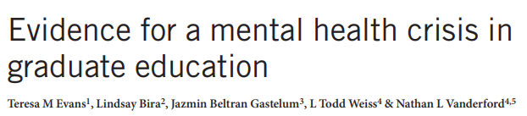
Fig 1. Number of Articles Published About PhD Student Well-being, by Year
Data source: Martínez‐García, I., De Witte, H., García‐Martínez, J., & Cano‐García, F. J. (2024). A systematic review and a comprehensive approach to PhD students' wellbeing. Applied Psychology: Health and Well‐Being, 16(4), 1565-1583.

Slide 10
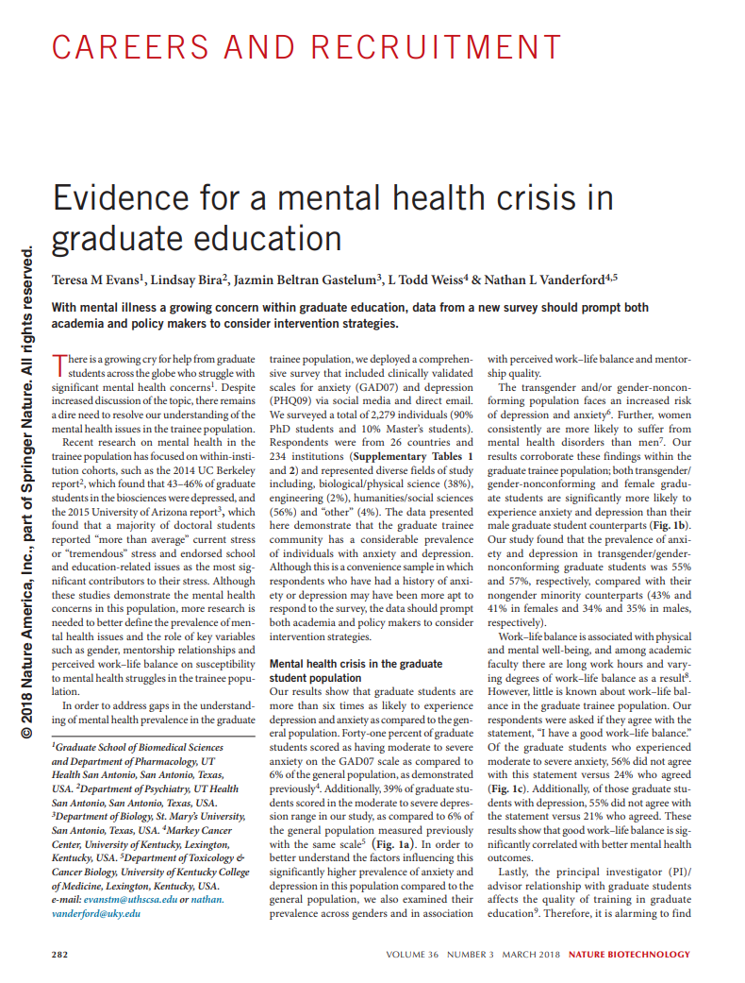
Design
Cross-sectional survey
Focus was on collecting clinical measures of anxiety and depression
Sample
Recruited via social media and email
90% PhD and 10% masters
From 26 different countries
Findings
Compared to the general population, graduate students were more than 6x as likely to experience depression and anxiety
Poor work-life balance and inadequate mentoring were related to depression and anxiety
Evans, T. M., Bira, L., Gastelum, J. B., Weiss, L. T., & Vanderford, N. L. (2018). Evidence for a mental health crisis in graduate education. Nature Biotechnology, 36(3), 282-284.

Slide 11
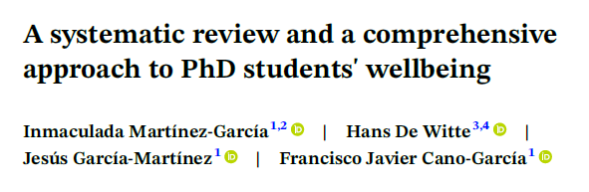
Limitations of Existing Literature (n=38)
Lack of longitudinal data
Small and non-diverse samples
No consensus definition of PhD student well-being
Martínez‐García, I., De Witte, H., García‐Martínez, J., & Cano‐García, F. J. (2024). A systematic review and a comprehensive approach to PhD students' wellbeing. Applied Psychology: Health and Well‐Being, 16(4), 1565-1583.

Slide 12

MDES- Background

Slide 13
Conceptual Model

Slide 14
Conceptual Model

Slide 15
Conceptual Model

Slide 16
Conceptual Model

Slide 17
Conceptual Model
Notes:
This developmental process influences students’ wellbeing, which in turn, feeds back into the process in an iterative manner over time
One thing the conceptual model makes clear is that the MDES is not a study of PhD student well-being. It is a study of student development over time, in which well-being plays a significant role. That means we can’t divorce student well-being from the graduate education context it occurs with.

Slide 18
Well-being Measures
Measure Name | Scale | Description
Subjective mental health | 5 points (Poor - Excellent) | Single measure of general self-rated health
Subjective physical health | 5 points (Poor - Excellent) | Single measure of general self-rated health
Perceived Stress Scale-4 * | 5 points (Never experience – Experience very often) | Measures the extent to which respondents found their lives unpredictable, uncontrollable, and overwhelming over the past month.
*Cohen, S., Kamarck, T., & Mermelstein, R. (1983)

Slide 19
Related Measures
Measure Name | Scale | Description
Satisfaction of Psychological Needs Scale (Autonomy, Competence, Relatedness) | 5 points (Not at all true – Very true) | Measures the degree to which individuals feel that within their departments/programs, they have choice and control over their lives (A), are effective and capable (C), and have a sense of connection with others (R).
Emotional Labor Scale | 5 points (Strongly disagree– Strongly agree) | Measures the degree to which advisees manage their emotions to meet their advisors’ expectations and requirements.
Abusive Mentoring Scale | 5 points (Advisor never uses this behavior - Advisor uses this behavior very often) | Measures the degree to which advisors engage in sustained display of hostile nonphysical behaviors with the advisee (e.g., yelling, lying)
Disciplinary Identity Scale | 5 points (Not at all – Extremely) | Measures the degree to which students identify as a scholar in their discipline

Slide 20
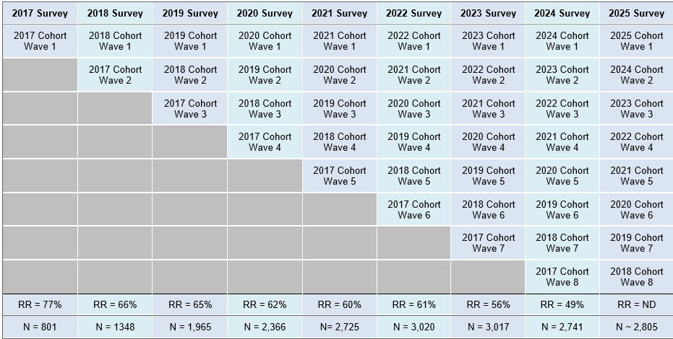
Study Design

Slide 21
Rackham Population vs. MDES Participants
 | Rackham Population | MDES Participants
% Female | 48 | 51
% International | 38 | 36
% Domestic Non-URM | 49 | 50
% Domestic URM | 13 | 13

Slide 22
MDES Research
How does PhD student well-being differ:
Over time?
Across types of students?
Across cohorts?

Slide 23




MDES Research

Slide 24

Findings:
Differences Over Time

Slide 25


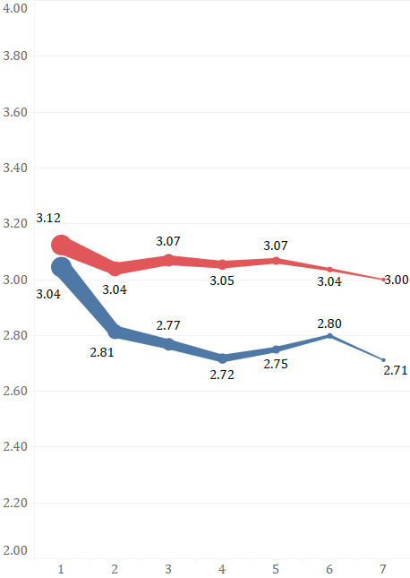
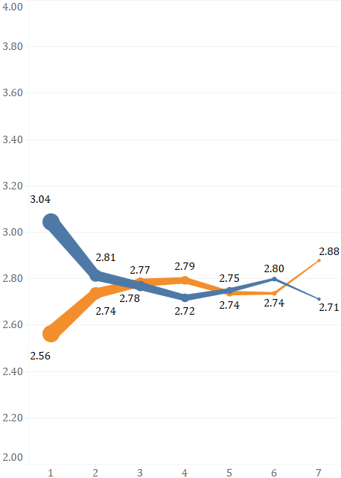
Average Mental Health, Physical Health, and Stress Ratings, by Year in Program
 | Year in Program |  | Year in Program
Health Rating
Stress Frequency
Very good
Fairly often
Good
Sometimes
Fair
Almost never

Slide 26

Transition points: Well-being and Disciplinary Identity in the First Years of Doctoral Studies
Gonzalez, J.A., Kim, H., & Flaster, A.
Studies in Graduate and Postdoctoral Education (2021) 12 (1): 26-41
Summary: Examines doctoral students’ trajectories of mental health, physical health and disciplinary identity during the first three years of doctoral study.
Research Question: What psychosocial factors, environments, and contexts differentiate the well-being and developmental trajectories of doctoral students?
Method: Group-based trajectory modeling (GBTM)
https://myumi.ch/dgVb1
Notes:
But students likely follow different well-being trajectories rather than a single pattern. We undertook a study to identify and examine those differences.

Slide 27
 | Thriving for Now (3%) | Treading Water (7%) | Rapid Decline (14%) | High but Falling (20%) | Continuing Struggle (20%) | Good, Not Great (37%)
Mental health
Physical health
Disciplinary identity
 | Year | Year | Year | Year | Year | Year

Slide 28
RQ: What factors differentiate the well-being and developmental trajectories of doctoral students?
 | Thriving for Now (3%) | versus | Continuing Struggle (20%)
Mental health
Physical health
Disciplinary identity
 | Year |  | Year
Notes:
Let’s look at the comparison of the “Thriving for Now” group and the “Continuing Struggle” group, as they had very different trajectories. Our regression analyses showed there were no differences by discipline type or in demographics. All differences were in entering stress levels, SDT needs satisfaction, and recognition from faculty. The bar graphs on the right show the average values for these variables for students classified as being in the “Thriving for Now” group and the “Continuing Struggle” group.
Points to emphasize:
Continuing Struggle students enter with much higher levels of stress and maintain those stress levels over 3 years
Continuing Struggle students enter with lower levels of their psychological needs being met and continue to be lower over three years
Continuing Struggle students report receiving less recognition from faculty for the quality of their work, ideas, and promise as a future scholar.

Slide 29
RQ: What factors differentiate the well-being and developmental trajectories of doctoral students?
 | Thriving for Now (3%) | versus | Rapid Decline (14%)
Mental health
Physical health
Disciplinary identity
 | Year |  | Year

Slide 30
RQ: What factors differentiate the well-being and developmental trajectories of doctoral students?
 | Thriving for Now (3%) | versus | High but Falling (20%)
Mental health
Physical health
Disciplinary identity
 | Year |  | Year
Notes:
Let’s look at the comparison of the “Thriving for Now” group and the “High but Falling Group” group, as they both started with high levels of well being and disciplinary identity, but different slopes,, particularly in mental health. Our regression analyses showed that there are significant differences in stress levels, SDT needs satisfaction, discipline type, whether students had published work before starting their PhD program, and sex. The bar graphs on the right show the average values for these variables for students classified as being in the “Thriving for Now” group and the “High but Falling” group.
Points to emphasize:
Both groups have fairly low levels of stress across all 3 years, but High but Falling group is higher
Both groups have high levels of their SDT needs being met, but Thriving for Now group is higher
Students in the High but Falling group are much more likely than the Thriving for Now group to be female, to have published before entering their program, or to be in a Biological Sciences and Health discipline

Slide 31

Findings:
Differences Across Types of Students

Slide 32

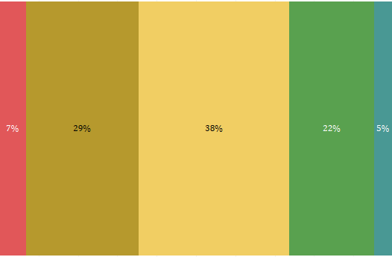
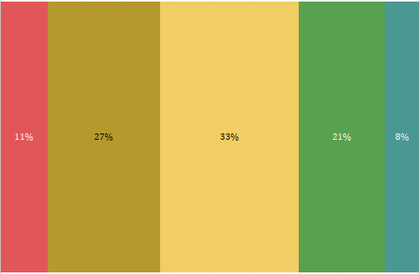
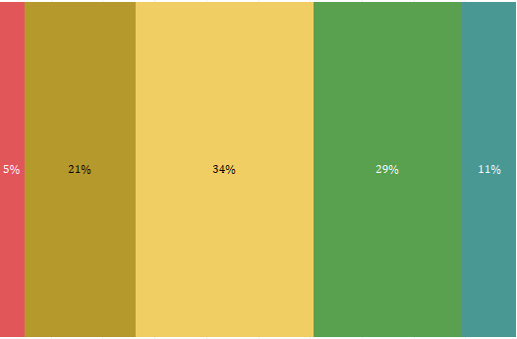
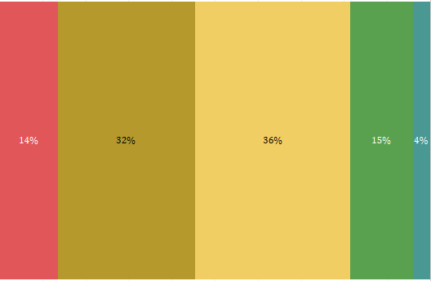
 | Self-Rated Mental Health in Year 1 and Year 5, by Sex
Female
Male
 | Year 1 | Year 5
 | Notes: Data is from Michigan Doctoral Experience Study, 2017-2024

Slide 33
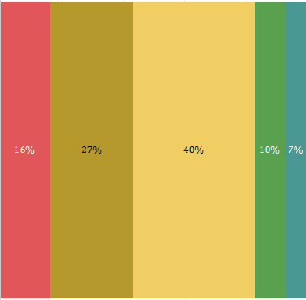
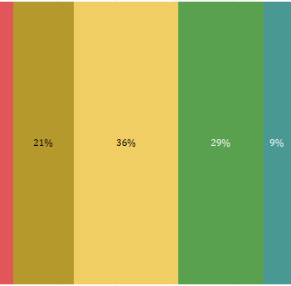
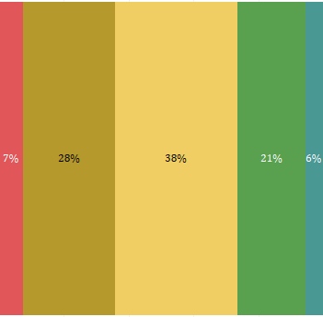
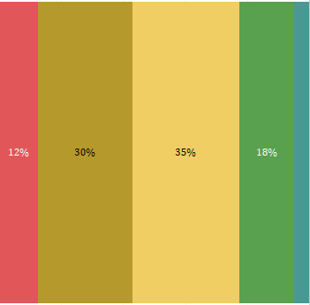
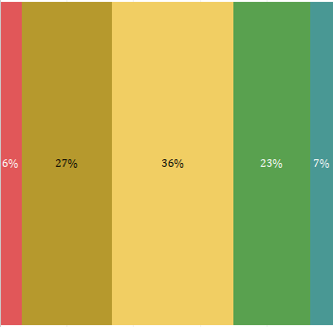
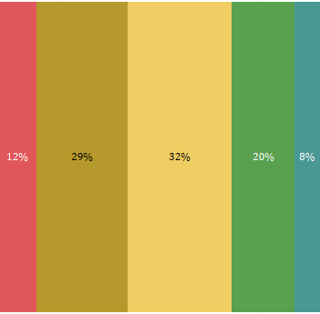
Self-Rated Mental Health in Year 1 and Year 5, by Citizenship and URM Status
Intl
Non-URM
URM
 | Year 1 | Year 5
 | Notes: Data is from Michigan Doctoral Experience Study, 2017-2024

Slide 34

Hostile Advisors: Prevalence, Forms, and Consequences of Abusive Supervision in Doctoral Education
Chen, Y., Bai, Y., Kim, H., & Gonzalez, J.,
Paper presented at the 2025 American Educational Research Association Annual Meeting, Denver, CO.
Definition of Abusive Supervision: Sustained nonphysical supervisory hostility towards subordinates
Examples of Advisor Hostility: Yelling at students, calling them incompetent, misappropriation of work, public shaming.
Research Questions: (1) What is the prevalence and distribution of abusive supervision among doctoral students? (2) How does abusive supervision influence students’ well-being and thoughts about program departure?
Method: Factor and regression analyses
myumi.ch/mRgm5

Slide 35
  RQ1: What is the prevalence and distribution of abusive supervision among doctoral students?

Slide 36
  RQ1: What is the distribution of abusive supervision among doctoral students?
  RQ2: How does abusive supervision influence students’ well-being and thoughts about program departure?
Abusive supervision is more likely among:
Students who identify as women
Physical sciences and engineering students (lenient definition only)
Biological and health sciences students (lenient definition only)
Abusive supervision is associated with
Decreased mental health
Higher stress
Higher intentions of quitting.
Controlling for advisor’s mentoring quality (e.g., career support) nullifies these associations.

Slide 37

The Hidden Cost: Emotional Labor, Mentoring, and Graduate Students’ Well-Being
Bai, Y., Chen, Y., Gonzalez, J., & Kim, H.
Paper presented at the 2025 American Educational Research Association Annual Meeting, Denver, CO.
Definition of Emotional Labor: The process by which employees are expected to manage or regulate their feelings to meet employer expectations, which often requires employees to express or suppress emotions
Example in Doctoral Education: A student expressing enthusiasm to their advisor about pursuing an academic career when they don’t actually feel that way
Research Questions: (1) What factors are related to the performance of emotional labor among doctoral students? (2) How does emotional labor relate to students’ mental health, stress levels, self efficacy, disciplinary identity, sense of belonging, and intent to quit?
Methods: Factor and regression analysis
https://myumi.ch/A1GVg

Slide 38
RQ1: What factors are related to the performance of emotional labor among doctoral students?
  RQ2: How does emotional labor relate to students’ well-being (including mental health, stress levels, self efficacy, disciplinary identity, sense of belonging, and intent to quit)?
Students that are more likely to perform emotional labor are those who:
  Lack support from their mentors
  Have higher levels of extrinsic motivation
  Have unmet autonomy and competence needs
  Are international students
Engaging in emotional labor as an advisee is associated with:
Decreased mental health ratings
Higher stress levels
Lower levels of self-efficacy and disciplinary identity
Lower level of sense of belonging in the discipline
Increased frequency of thinking about quitting doctoral study

Slide 39

Findings:
Differences Across Cohorts

Slide 40
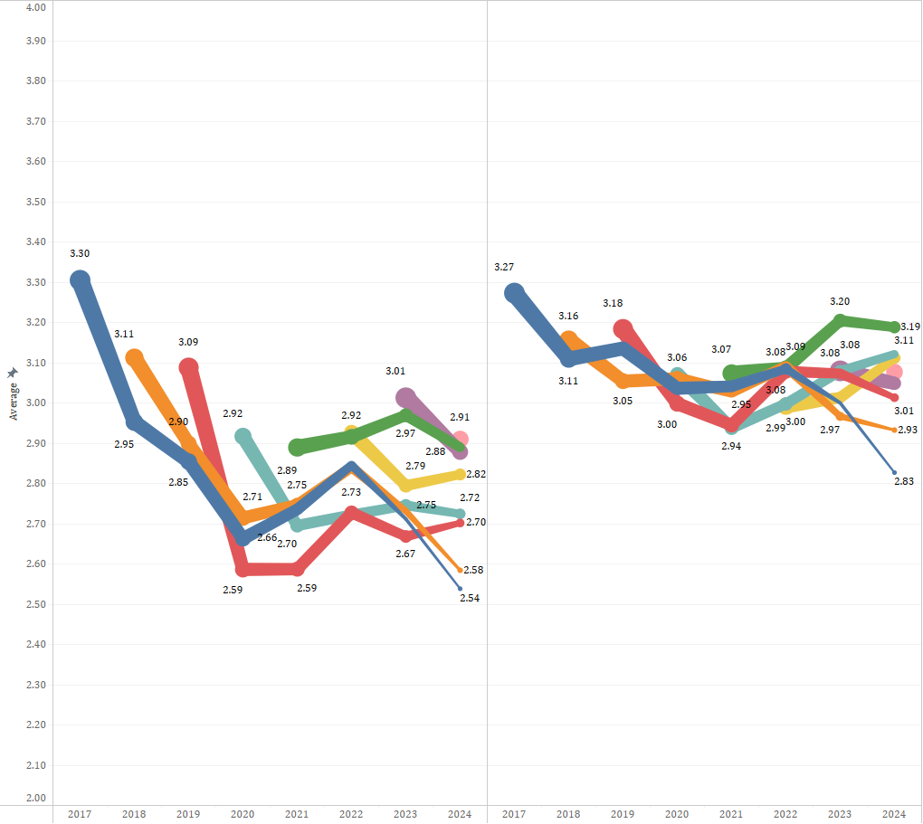

Components of Well-being Across Calendar Year, by Entering Cohort
 | Mental Health | Physical Health

Slide 41

Doctoral Student Development in Time of Crisis: Implications of COVID-19 on Well-being and Academic Development
Kim, H., Haddad, N., Clasing-Manquian, P., & Gonzalez, J. A.
Paper presented at the 2021 Association for the Study of Higher Education Annual Conference (virtual)
Summary: Quantifies the impact of the COVID-19 pandemic on student well-being by comparing pre- and post-pandemic cohorts.
Research Question: How do doctoral students develop across basic psychological needs, disciplinary knowledge, disciplinary identity, and stress during COVID-19?
Method: Multi-level modeling
https://myumi.ch/z9g5b

Slide 42

Take-Aways and Insights

Slide 43
Trends in Well-being
On average, well-being declines slightly over the course of doctoral study, with the biggest drop during the 1st year
  Mental health declines more than physical health
Students from different backgrounds tend to start their programs with different levels of well-being
  International and male students have higher levels of well-being than domestic and female students. Non-URM students have higher levels than URM students.
The strongest predictor of students’ well-being throughout doctoral study is their well-being at the start of their program

Slide 44
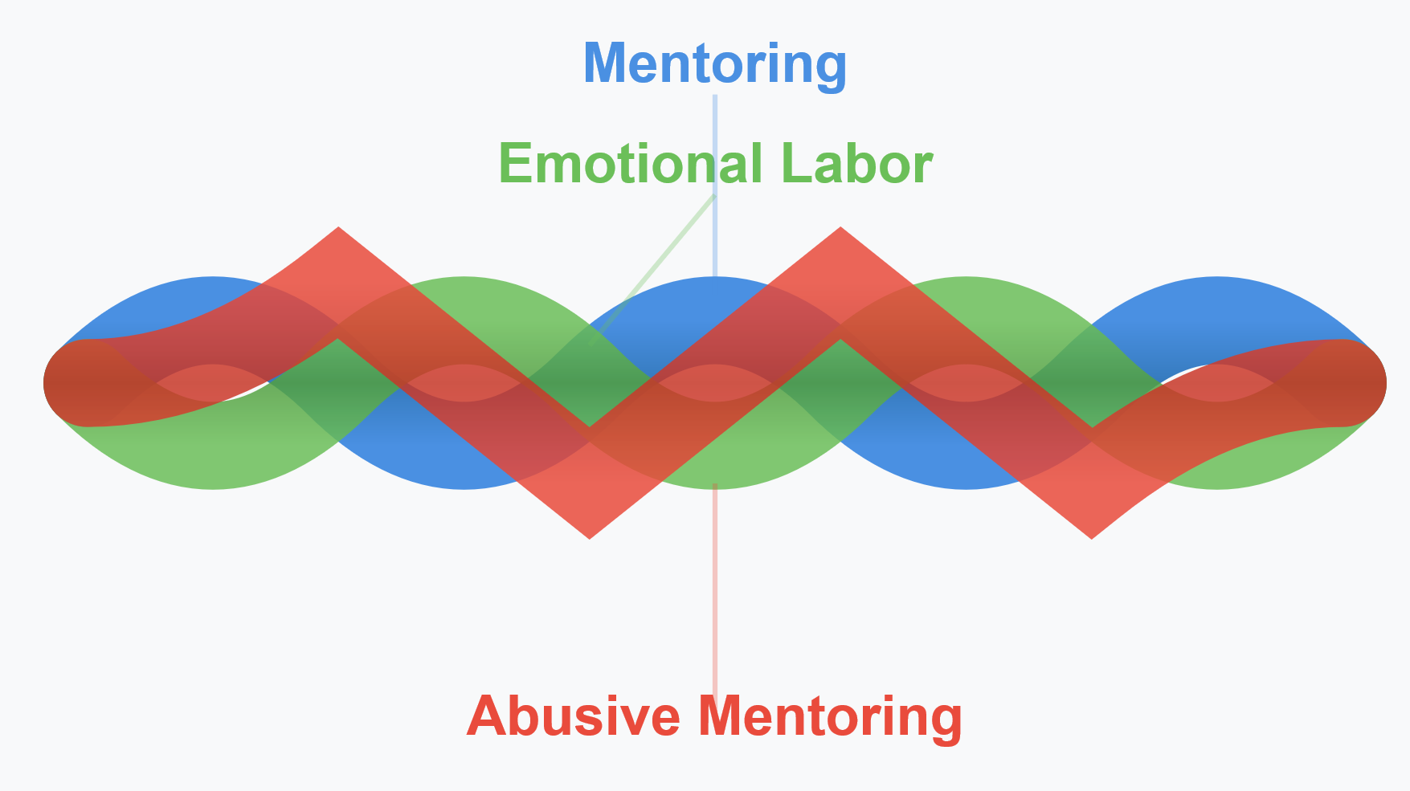
Influences on Well-being
  Stress
  Has a strong negative relationship with mental health
  Psychological Needs Satisfaction (Autonomy, Competence, Relatedness)
  Predictive of well-being across numerous studies
Faculty Advising & Mentoring
There is a relationship between lacking mentor support, abusive supervision, and engaging in emotional labor
Abusive supervision is relatively rare
                Larger Social Contexts
                Produce cohort differences in entering levels of well-being
                Can also have a pervasive influence across all cohorts (see Covid-19)

Slide 45
A Tentative Model of Well-being
Social Context
Student Background
Citizenship
Sex
URM status
Prior Academic Experiences
Program Experiences
Faculty
Psychological Needs
Mentoring Quality
Abusive Supervision
Expectation Alignment
Autonomy
Competence
Relatedness
Disciplinary Self-perceptions
Emotional Labor
Self-Efficacy
Sense of Belonging
Identity
Motivation
Stress
Intent to Quit
Mental Health
Physical Health

Slide 46
Questions?
John Gonzalez
Director
Rackham Institutional Research
jagonza@umich.edu
Allyson Flaster
Senior Research Analyst
Rackham Institutional Research
aflaster@umich.edu

Slide 47
Study Development
Rackham Staff
Faculty Advisory Board
Student Input
Institutional Research Office
Center for Research on Learning and Teaching
15 focus groups with 93 students
Dean’s Office
College of Engineering
Partnerships for Access, Community, and Excellence Team
College of Literature, Science, and the Arts
Marsal School of Education
School of Public Health

Slide 48
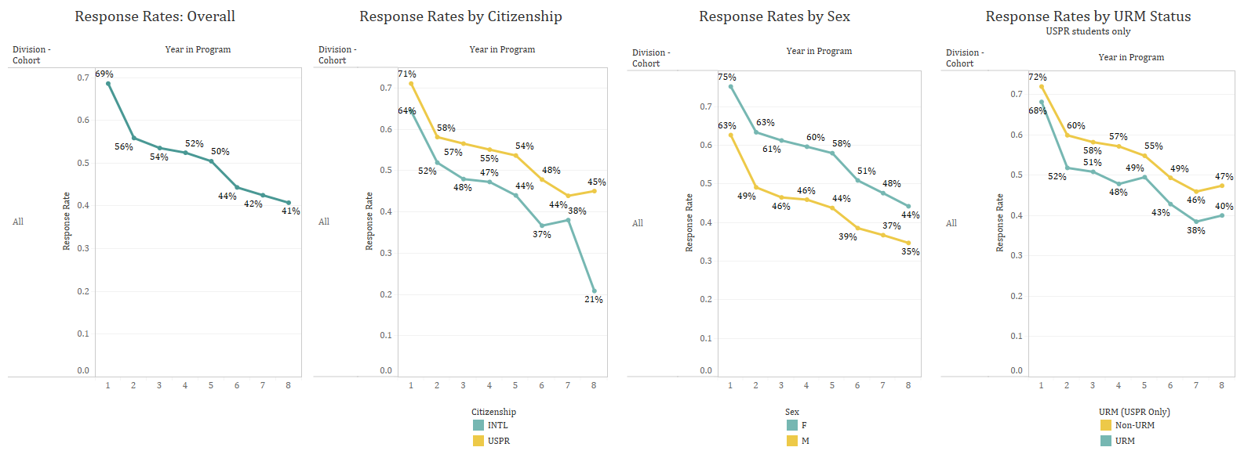
Response Rates

Slide 49
Self-Rated Mental Health in Year 1 and Year 5, by Discipline Type
Bio & Health
Phys Sci & Eng
Soc Sci
Hum & Arts
 | Year 1 | Year 5
 | Notes: Data is from Michigan Doctoral Experience Study, 2017-2024
Notes:
Disciplinary differences are the only ones where disparities in mental health ratings appear to have grown between Year 1 and Year 5. The % of social science students who rate their mental health as fair or poor has grown more than the other disciplines.

Slide 50
  What is the prevalence and distribution of abusive supervision among doctoral students?
Demographic and Academic Predictors of Advisor Abuse Using Different Model Specifications
 | Binary (Strict) | Binary (Lenient) | Linear (OLS) | Quantile (95th)
Predictor | Coef | Coef | Coef | Coef
Age | 1.01 | 1.01 | −0.00 | 0.01
Women | 1.56* | 1.46* | 0.09* | 0.28*
URM | 1.49 | 1.27 | 0.07 | 0.38
Non-URM Minority | 0.90 | 1.10 | 0.03 | −0.05
International | 1.42 | 1.25 | 0.08 | 0.35*
First-Generation | 1.04 | 0.88 | −0.04 | 0.00
LGBTQIA2S+ | 1.19 | 1.09 | 0.13* | 0.15
Phys. Sciences & Eng. | 1.63 | 2.18*** | 0.26*** | 0.16
Bio. & Health Sciences | 1.74 | 1.91** | 0.19** | 0.30*
Hum. & the Arts | 0.68 | 0.66 | −0.27*** | −0.29
N | 2,009 | 2,009 | 2,009 | 2,009
R² | .050 | .051 | .072 | —

Slide 51
  How does abusive supervision influence students’ well-being and thoughts about program departure?
Impacts of Abusive Supervision on Student Outcomes
Outcome | Model 1- w/o mentoring controls | Model 2- with mentoring controls
Mental health | −0.275** | −0.054
Stress | 0.188*** | 0.028
Intent to quit | 0.361** | 0.018
Control Variables Included
Demographic characteristics | Yes | Yes
Discipline & Year in program | Yes | Yes
Mentoring support | No | Yes

Slide 52
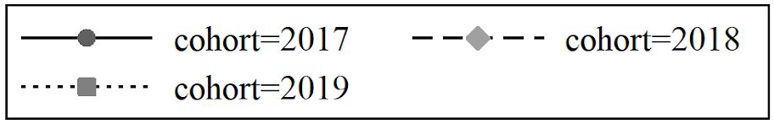
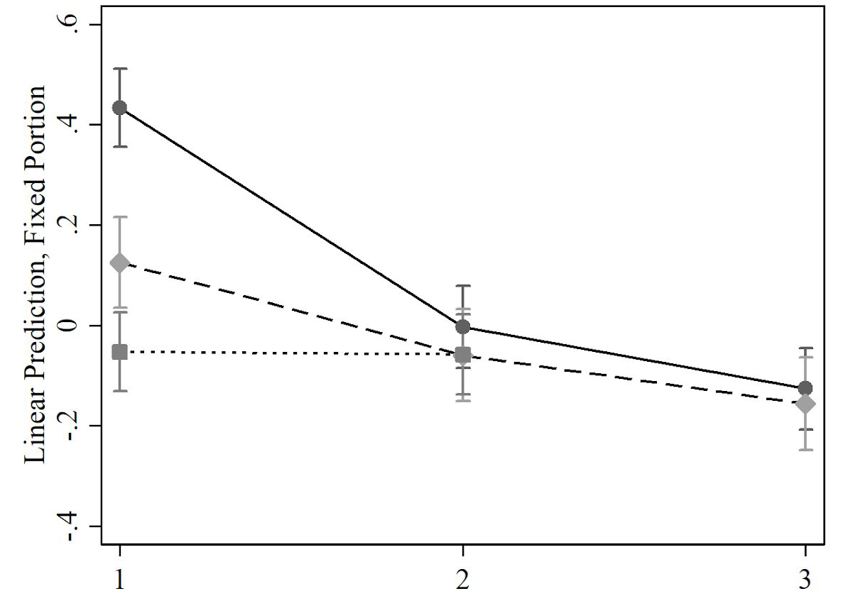
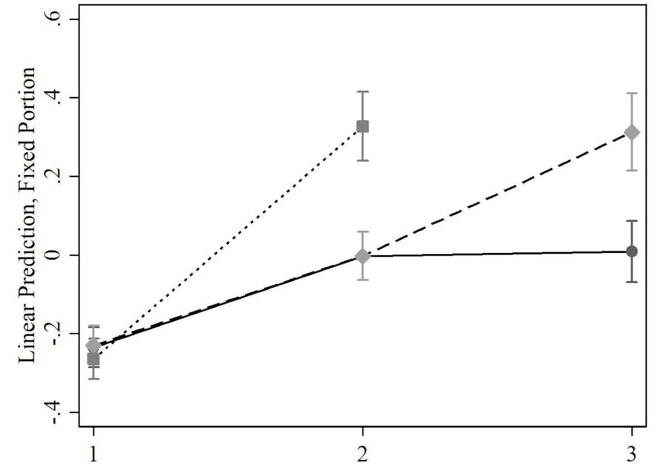
How do doctoral students develop across psychological needs, knowledge, disciplinary identity, and perceived level of stress during COVID-19?
Fig 1. Standardized Stress Scale Score, by Cohort |  | Fig 2. Standardized Identity Scale Score, by Cohort
Year in Program |  | Year in Program
Notes:
No significant association was found between the COVID-19 years and autonomy, competence, relatedness, and knowledge levels.
Regarding stress, we found that the pandemic disruptions exacerbated the pre-existing stress levels associated with the first and second years. While the cohorts 2017 and 2018 have an identical trajectory before the pandemic, the trajectories during the pandemic show a substantially steeper slope. See Fig 1. Regarding disciplinary identity, we found that students engaged in doctoral studies during the COVID-19 pandemic had, unexpectedly, lower decreases in disciplinary identity than those engaged in studies at similar points before the pandemic. See Figure 2.
Therefore, due to Covid, cohorts experienced significantly different levels of stress and disciplinary identity development during the important first year of doctoral study,

